Slide 1



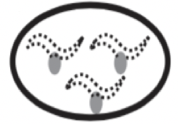
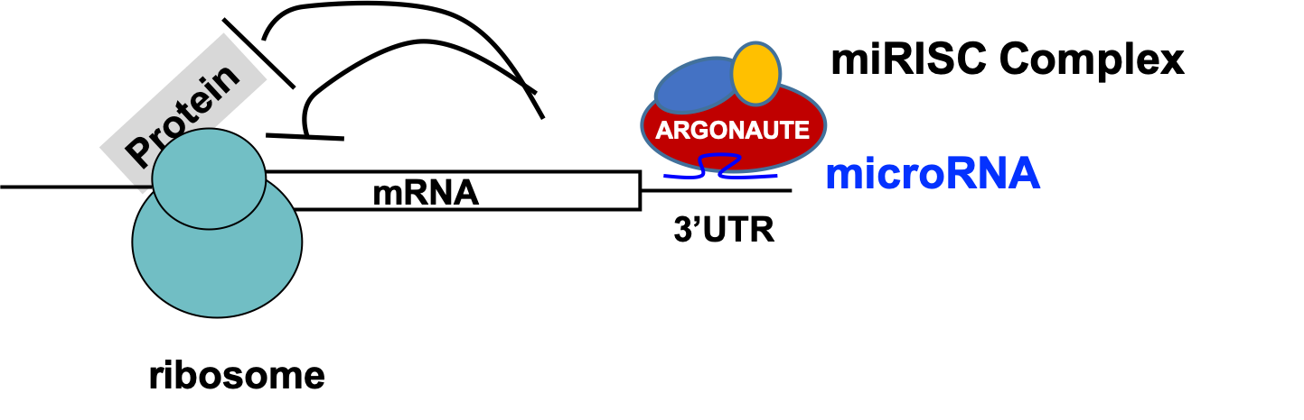
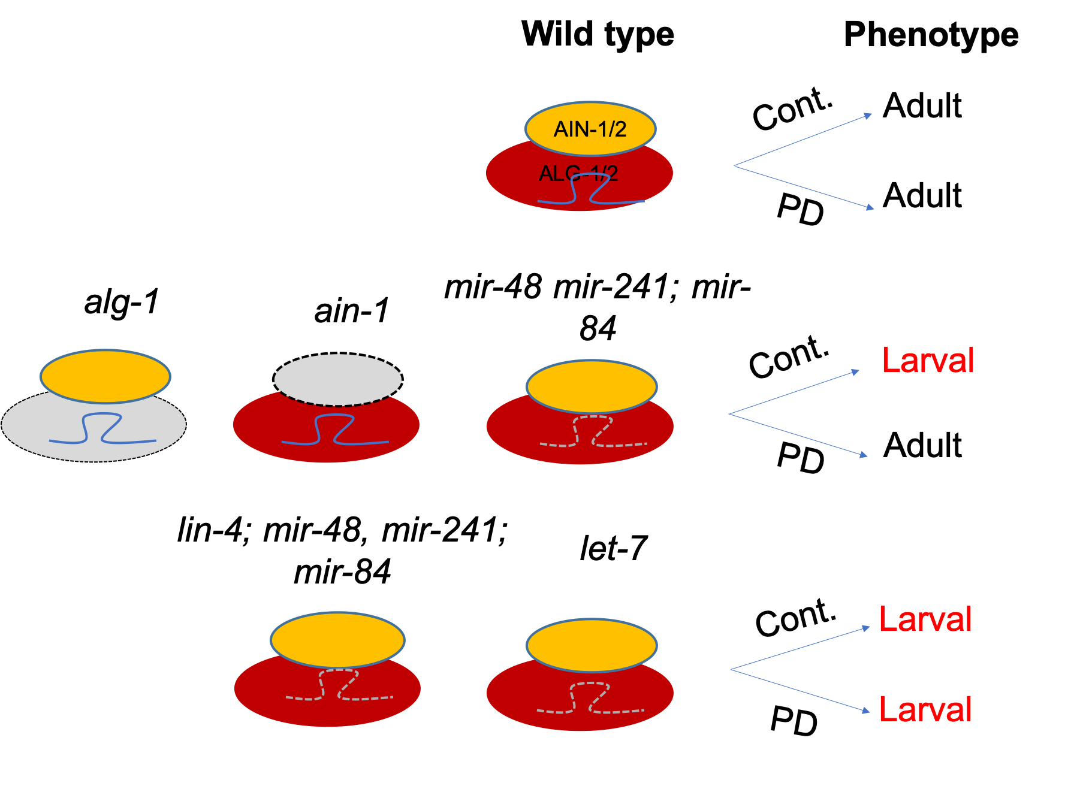
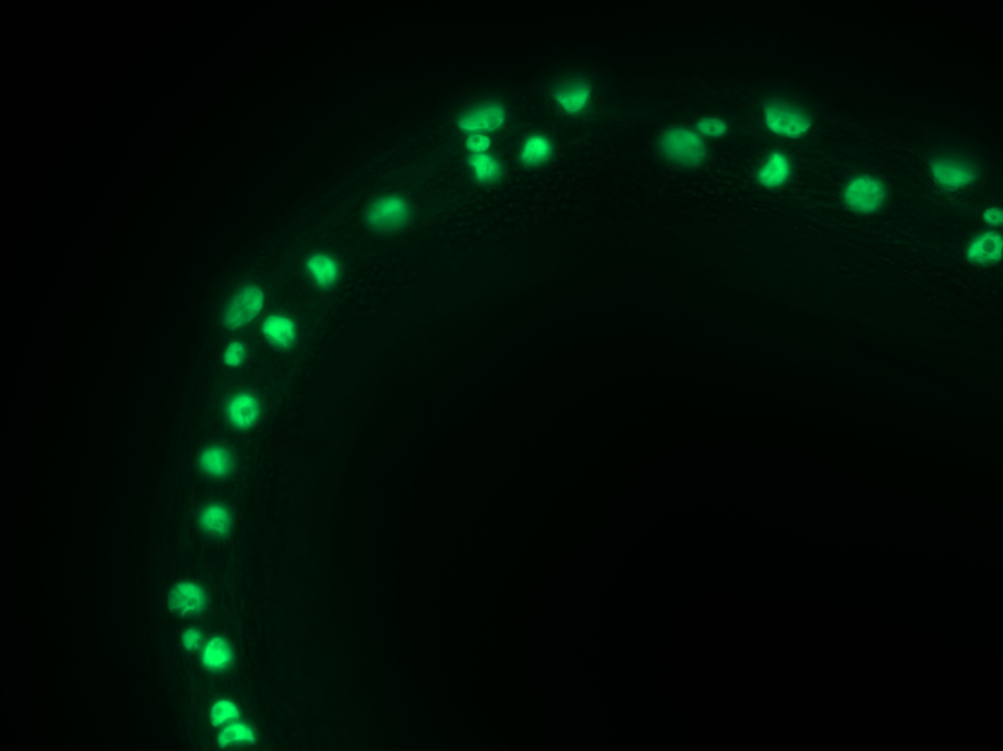
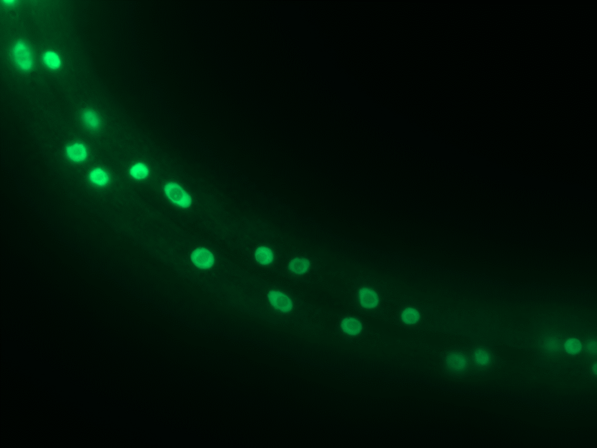

An RNAi screen to identify factors that enhance microRNA
activity after dauer
Himal Roka¹ and Xantha Karp^{1,2}
Big Picture Question
RNAi Screen
Question
How do animals develop normally after a period of arrest?
A
B
How does nekl-3 interact with alg-1 during continuous development?
PD WT
PD alg-1(0)
Introduction
0
0
A
1367 genes
% of worms bursting and/or Pvl
1. Primary screen
C
Screen for bursting/Pvl: 276 genes screened so far
Post-dauer alg-1(0)
RNAi
kin-3 control
Genes that promote miRISC activity: 23
B
lacZ control
Most genes
% of worms with retarded col-19::GFP
Fig. 1: Seam cell development occurs normally after dauer diapause. Dauer is a developmental arrest occurring after the second larval molt in response to adverse environments. The pattern and sequence of lateral hypodermal seam cell divisions occurs identically in continuously developing and post-dauer worms. At adulthood, seam cells differentiate and express adult-specific characteristics. Heterochronic genes specify larval vs. adult cell fate (1,2).
D
% of worms with bursting and/or Pvl
Expected
Novel
Fig. 6: nekl-3 is more important to regulate col-19::gfp expression after dauer than during continuous development. RNAi of nekl-3 and controls in alg-1(0) animals that developed continuously (Cont D.) or experienced dauer (PD). Post-dauer animals contained the daf-7(e1372) mutation whereas continuously developing animals did not. These are preliminary data from a single experiment. (A) alg-1(0) bursitng and Pvl phenotypes are already highly penetrant during continuous development. Surprisingly, nekl-3(RNAi) may have suppressed this phenotype slightly, but more experiments are needed to confirm this. (B) alg-1(0) adults rarely display col-19::gfp defects whether they develop continuously or rhtough dauer. kin-3(RNAi) does not enhance this phenotype. By contrast, nekl-3(RNAi) produces a penetrant col-19::gfp defect in post-dauer alg-1(0) animals.
A
Transcription Factor
B
level
miRNA
2. Retest hits
C
Early
Late
E
alg-1(0)
lacZ(RNAi)
alg-1(0)
kin-3(RNAi)
alg-1(0)
nekl-3(RNAi)
0/48
28/38
52/80
Future Directions
Fig. 4: nekl-3 is a primary hit in an RNAi screen for genes that enhance alg-1(0) phenotypes after dauer. (A) List of genes to screen. All genes are conserved in humans (5). RBP = RNA binding protein. (B) Validating negative and positive controls for the screen. ”Wild-type” and alg-1(0) strains contain daf-7(e1372) to control dauer formation. kin-3 encodes the catalytic domain of casein kinase 2, which phosphorylates a miRISC component to promote miRISC activity (6). (C) Strategy for the RNAi screen. Each clone is scored in duplicate (D) Hits from the primary RNAi screen. Combined data from two RNAi wells is shown. Expected genes are known heterochronic genes, miRISC components or miRISC regulators. (E) After retesting the hits from the primary screen, nekl-3 emerged as the only strong candidate. nekl-3 (Never in mitosis Kinase Like) encodes a serine/threonine kinase that regulates molting (7). Arrows indicate the vulva (normal or burst).
Test other molting regulators for enhancement of alg-1(0) post-dauer phenotypes
Further characterization of nekl-3
  Genetic interactions with other miRISC components
  Genetic interactions with microRNAs and microRNA targets
  Post-dauer expression pattern
  Physical interactions with miRISC
Continue primary screen
Fig. 2: MicroRNA activity is enhanced after dauer. (A) Transcription factors specifying early cell fates are downregulated by increasing levels of microRNA to allow progression to later cell fates (3). (B) Model showing components of microRNA Induced gene Silencing Complex (miRISC) which silences target genes post-transcriptionally. (C) Some mutants with compromised miRISC activity develop normally after dauer, suggesting an enhancement of miRISC activity after dauer compared to continuous development (4)
References
Research Question
Question
Ambros & Horvitz, 1984. Science 226: 409-416.
Liu & Ambros, 1991. Nature 350: 162-165.
Rougvie, A. E. 2001. Nat. Rev. Genet. 2, 690-701.
Karp & Ambros, 2012. Development 139: 2177-2186.
Shaya and Greenwald, 2011. Ortholist. PLoS ONE 6, e20085.
Alessi et al., 2015. PNAS 112: E7213-22.
Yochem et al., 2015. Dev. Bio. 398: 255–266
What factors enhance post dauer microRNA activity?
Is nekl-3 more important when miRISC is compromised?
Wild type
Cont. alg-1(0)
PD alg-1(0)
Acknowledgements
DIC
Bursting
Pvl
% of worms with defective phenotype
Thanks to Himani Galagali and Dr. John Kim (John Hopkins University) for sharing data and helpful discussions. Many thanks to thesis committee members Dr. Jennifer Schisa and Dr. Steven Gorsich (CMU) for their timely advice. Thanks to my team members Alexendra Terry, and Claudia Chabay. Thanks to WormBase for information. This project is funded by an NSF CAREER award (to XK), a CMU College of Science and Engineering research assistantship and a CMU Biology department teaching assistantship (to HR).
Affiliations:
1) Biochemistry, Cell & Molecular Biology Program, Central Michigan University
2) Department of Biology, Central Michigan University
col-19::GFP
Gapped alae
Fig. 3: The alg-1(0) phenotype is suppressed in post-dauer animals. alg-1(0) animals are viable due to the presence of alg-2, but display phenotypes including vulval bursting, protruding vulvas (Pvl), gaps in an adult-specific cuticular structure (alae), and reduced expression of the adult cell fate marker col-19::gfp. All of these phenotypes are suppressed after dauer. “Cont.” = continuous development, ”PD” = post-dauer.
Fig. 5: RNAi of nekl-3 in alg-1(0) mutant post-dauers causes a higher penetrance of bursting/Pvl phenotypes than in a wild-type background. All strains contain daf-7(e1372) to control dauer formation.

