Slide 1

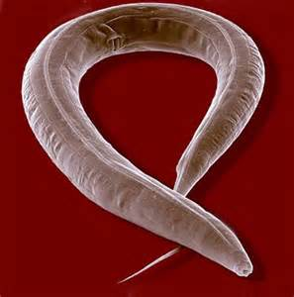
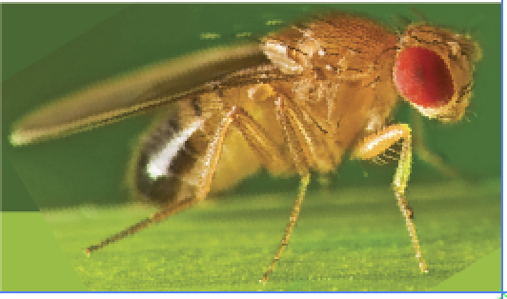




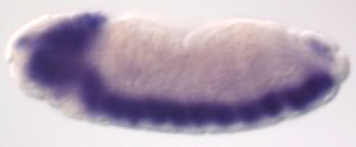
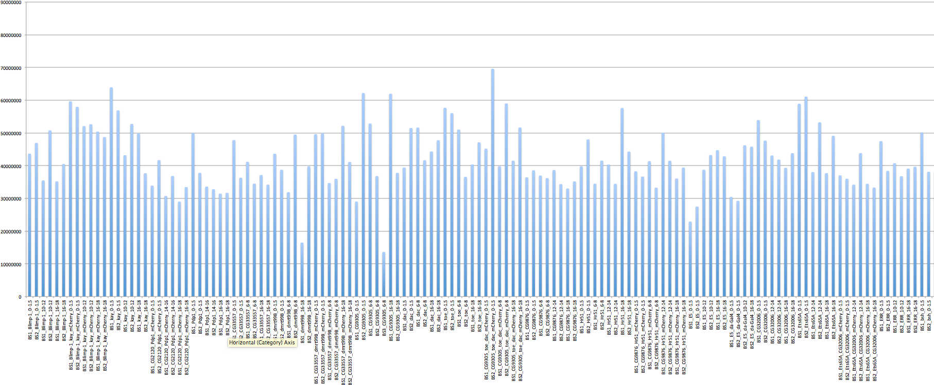
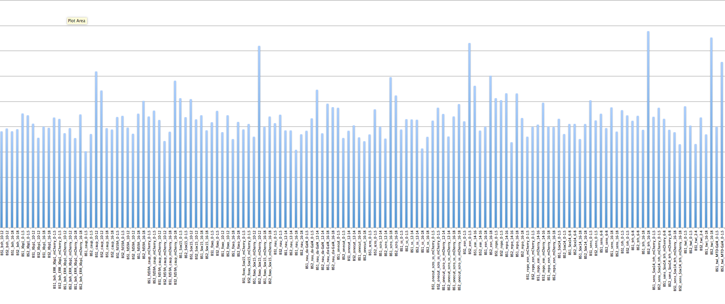
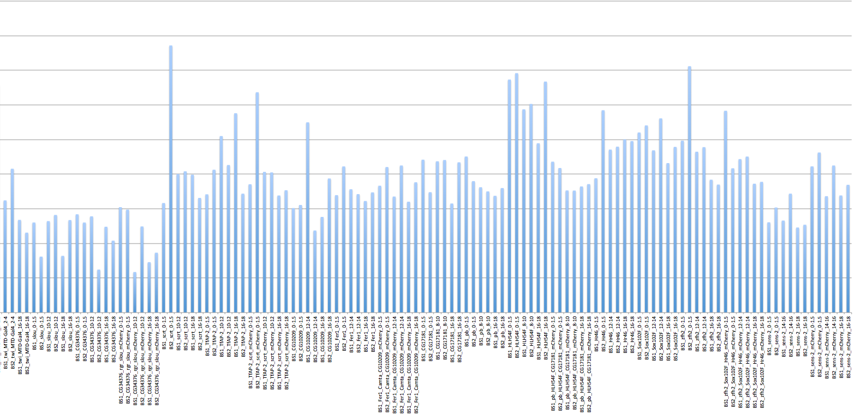
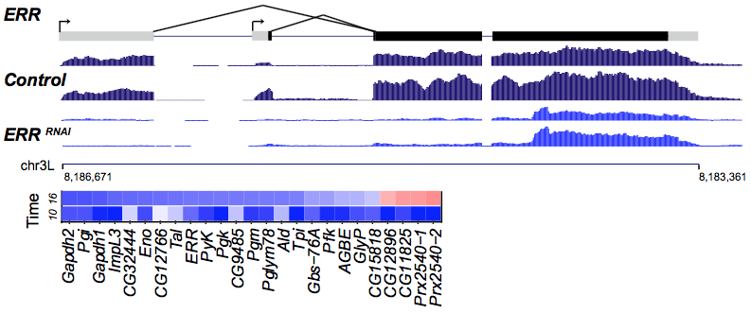
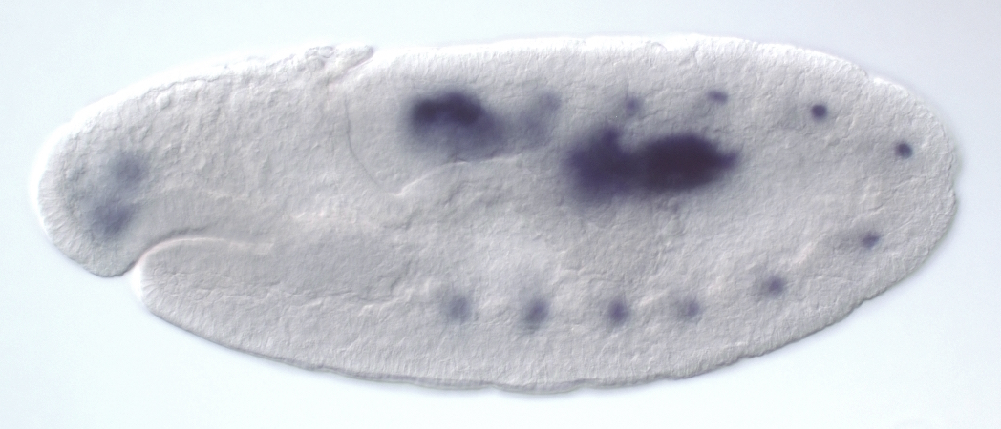
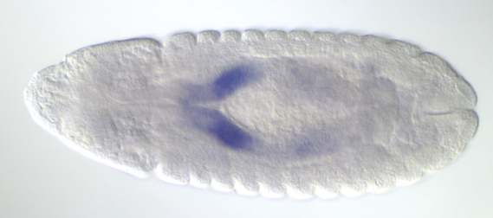
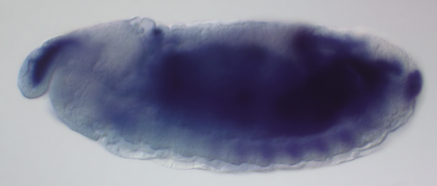
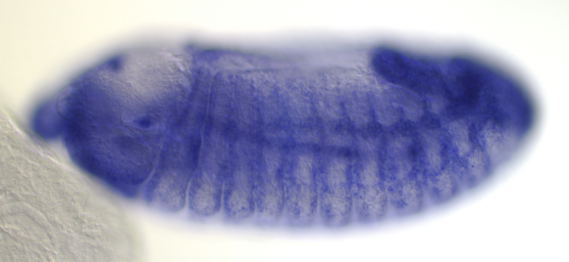
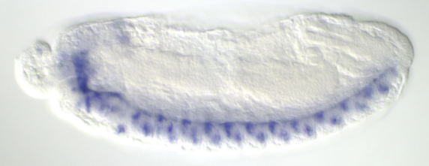
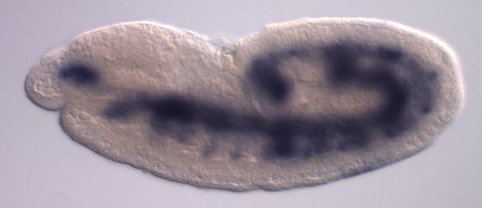
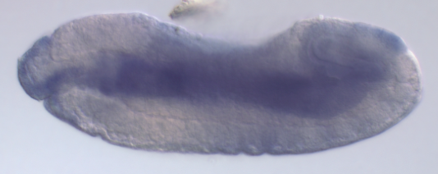
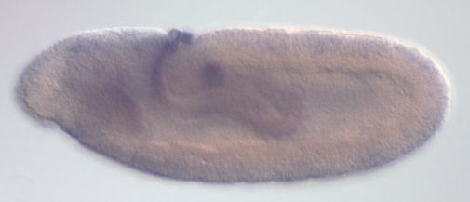
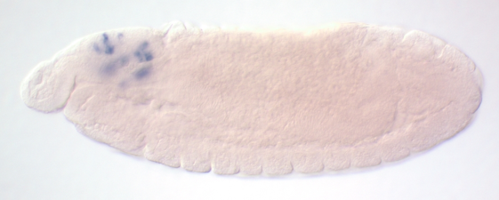
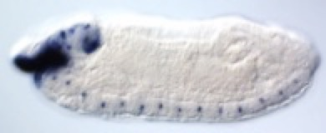

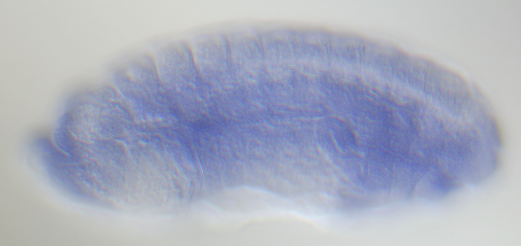
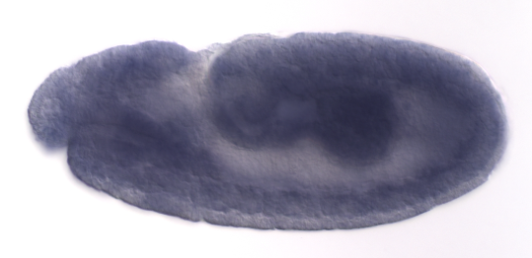
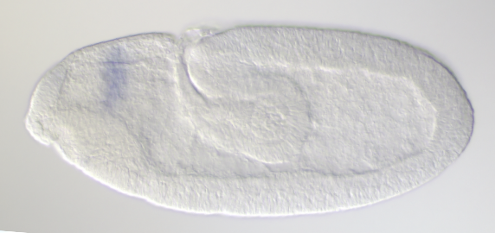

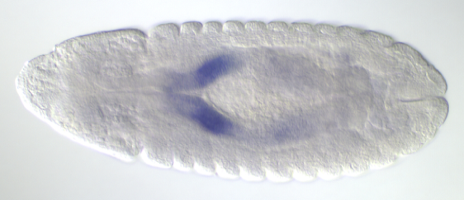
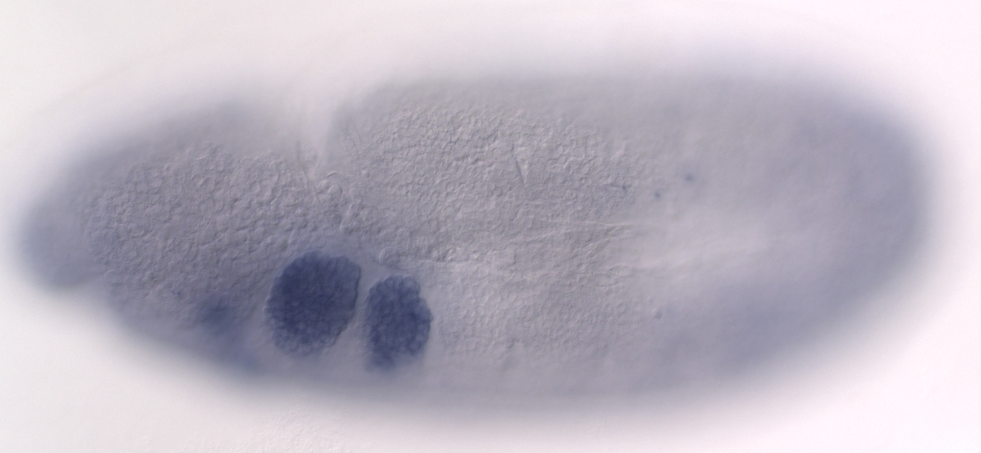
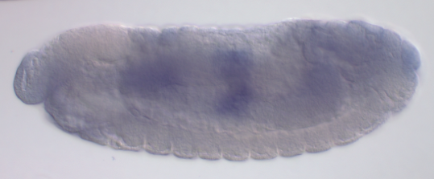
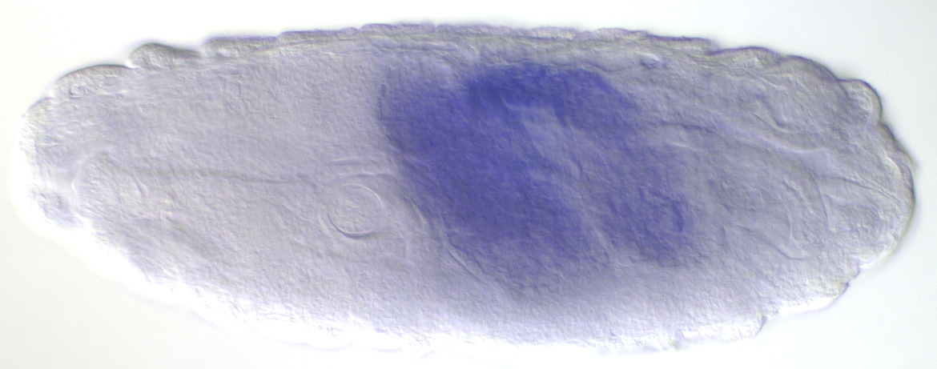
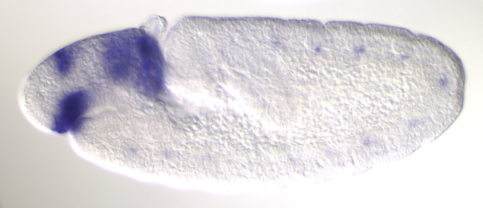
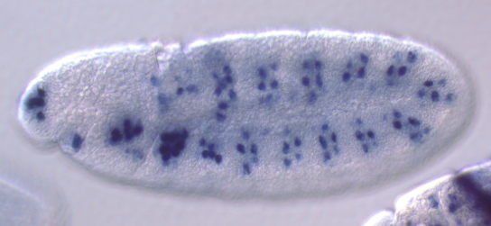
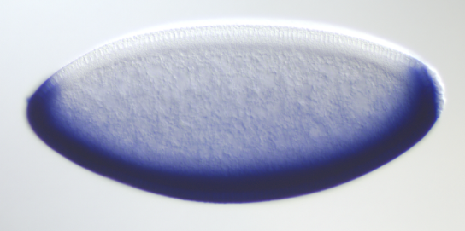
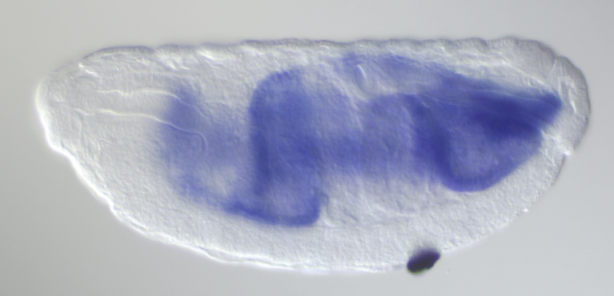
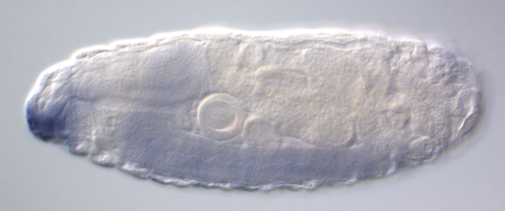
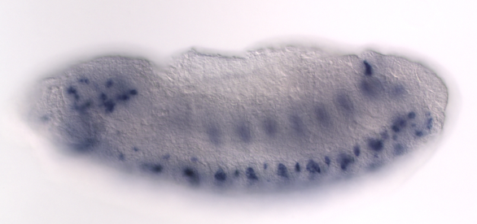
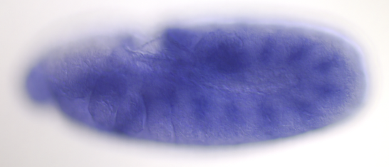

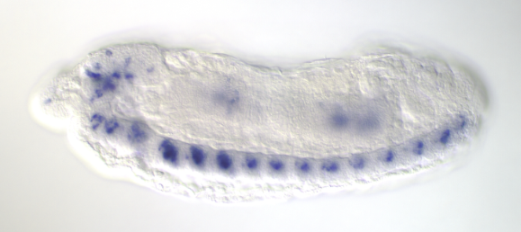
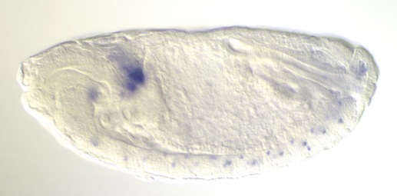
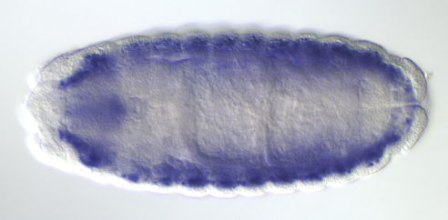
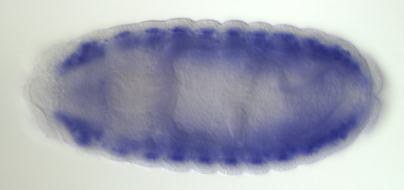
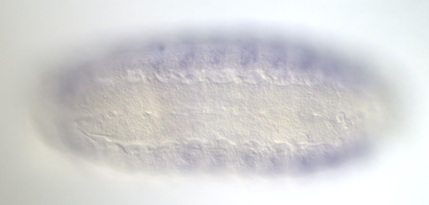
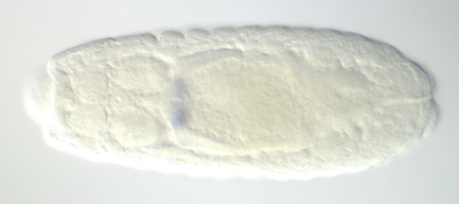
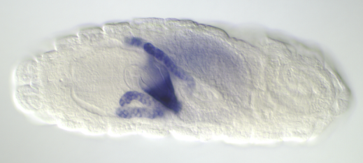
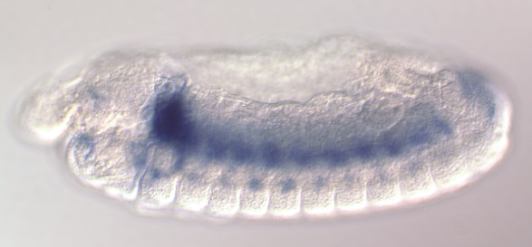
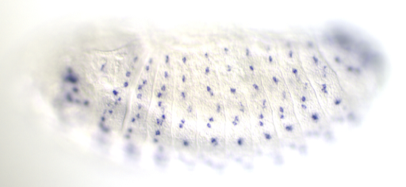
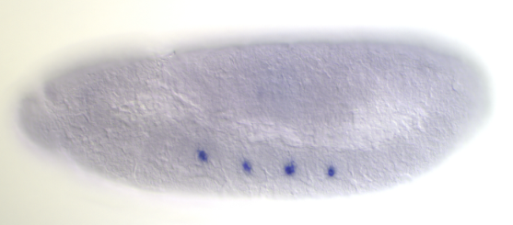
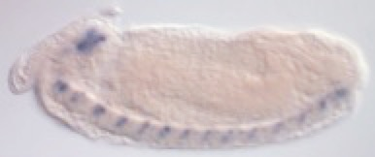

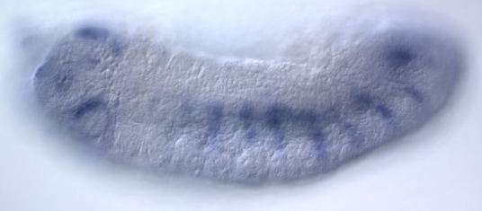
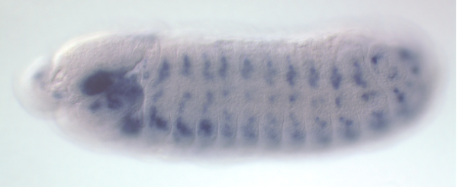
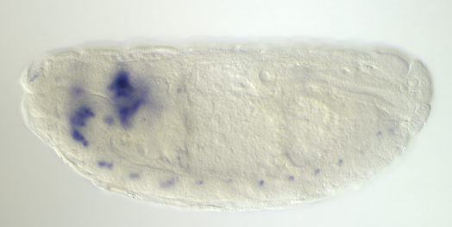
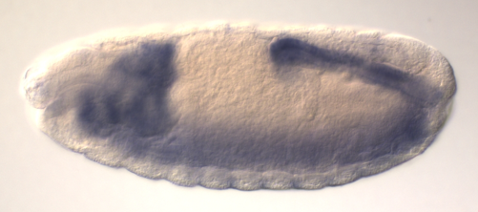
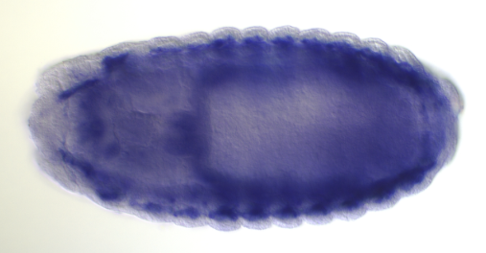
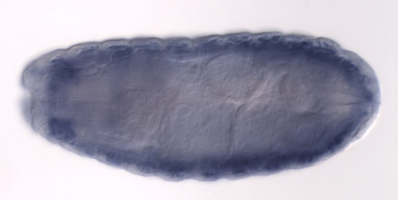
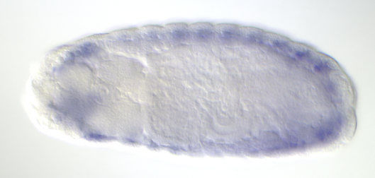
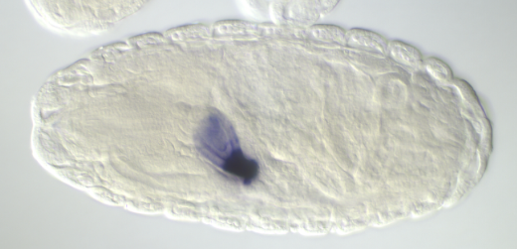





















Model organism Encyclopedia of Regulatory Networks (modERN) validation using Drosophila Transcription Factor RNAi and RNA-seq
625A
Placeholder for log2 fold
modERN
William W Fisher¹, Ann S Hammonds¹, Richard Weiszmann¹, Ben Booth¹, Alec Victorsen³, Jaeda Patton²,
Connor Kubo², Mark Gerstein⁴, Kevin White³, Valerie Reinke⁴, and Bob Waterston² and Susan Celniker¹
1 - Lawrence Berkeley National Laboratory, 2 - University of Washington, 3 - Northwestern University, 4 - Yale University
Placeholder for log2 fold
Abstract
Our goal is to create comprehensive maps of transcription factor (TF) binding sites in D. melanogaster and C. elegans. To validate these maps we are conducting RNAi knockdowns of embryonically-expressed Transcription Factors (TFs) followed by RNA-seq to identify potential targets of each TF. We used the TRiP lines from the Drosophila RNAi Screening Center to knock down TF expression measured in biological replicate at three time points: 0-1.5 hrs, 16-18 hrs and the 2 hr period of maximal embryonic expression for each TF. To date we have examined 43 TFs, generating over 400 samples for RNA-seq. About one third of the RNAi TF knockdowns resulted in lethal phenotypes, either as embryos (4), larvae (10), or pupae (2). In the RNAi knockdown of the transcription factor Estrogen Related Receptor (ERR), almost all animals died during the larval period. Of the 20 genes whose expression was most reduced (log2fold change > -1) after knockdown of ERR expression, ten genes encode enzymes required for glycolysis and their transcripts are expressed primarily in muscle. Of the remainder, six are required for carbohydrate metabolism and four appear to be part of a small operon. Two are known peroxidases and two are yet to be fully characterized. Our ChIP-seq experiments show the location of ERR binding sites near ERR RNAi identified target genes, close to their promoters or within their first introns. In the case of the target gene Lactate dehydrogenase (Ldh), ERR binding sites are clustered with Ecdysone receptor (EcR) binding sites. RNA-seq data are available at encodeproject.org for access by the research community.
Placeholder for log2 fold
Meso-Muscle
Genes Completed RNAi pipeline
onecut
80 million
Mapped Reads for RNAi knockdown Drosophila TFs
A
ERR knockdown reduces expression of glycolysis genes
HLH54F
Foregut-Midgut-Hindgut
CNS
70 million
ERR
Pdp1
Blimp-1
repo
60 million
kah
foxo
Sox14
bsh
scro
50 million
nau
Hr46
CG9305
40 million
dac
scrt
30 million
pb
kayak
CG10209
dmrt99B
sens
20 million
B
C
ERR
twi
scro
CG34376
esn
slou
10 million
-1.20
Xbp1
sens-2
Ets65A
Sox102F
Dataset | Number of reads
BS1_CG34376_rgr_slou_mCherry_10-12 | 11710642
BS2_CG34376_10-12 | 12425040
BS3_CG9305_6-8 | 13619878
BS1_CG34376_rgr_slou_mCherry_16-18 | 14559918
BS2_slou_0-1.5 | 16169908
BS1_slou_16-18 | 16387964
BS1_dmrt99B_16-18 | 16494066
BS2_CG34376_rgr_slou_mCherry_16-18 | 17303954
D
Glycolysis and related genes
Proventriculus
Gastric caecum
Tracheal
PNS
Ectoderm
fd59A
tfAP-2
Pgi
Pgk
Tpi
CG15818
CG6933
caup
Sox15
CG9876
Fer1
zfh2
Gapdh1
-1.41
CG9485
-2.05
-2.35
CG7298
-1.32
Pebp1
-0.80
E5
ss
Salivary Gland
Hr51
CG33557
Pfk
trh
CG32006
toe
ImpL3/Ldh
-1.91
Pglym78
-0.47
AGBE
-1.85
CG7017
-0.92
CG8629
-0.78
Figure 1. Wild Type expression patterns of 43 genes used in RNAi experiments, grouped by organ system. Pattern shown is at the stage of maximum expression during embryogenesis. Red boxes indicate that the RNAi was lethal at either embryonic, larval, or pupal stages.
Figure 3. RNA Seq read counts for 390 experimental datasets. Only eight sets are short of 20 million reads.
Pyk
-2.71
Ald
-1.58
GlyP
-1.80
Muc26B
-0.63
CG6126
-0.57
Clustering of RNAi datasets for 43 TFs at three time points each
E
-1.62
-0.56
-1.45
-0.59
-0.52
TF RNAi cross (ERR example):
RNAi Genetic Scheme
Control cross using mCherry:
Figure 5. (A) RNA-seq shows significant knockdown of ERR expression in ERR RNAi-treated embryos compared to the mCherry controls. (B) Heat map showing the genes with the greatest changes in expression in response to ERR knockdown at two time points: 10-12 hours AEL and 16-18 hours.
(C) Wild type expression of ERR RNA is primarily in the midgut.
(D) Wild type expression patterns of genes knocked down by ERR RNAi. At least 15 are involved in glycolysis or glycogenolysis and expressed in somatic muscle. (Gapdh2, Pgm1, Eno not shown). Four are expressed primarily in the proventriculus and another four in the gastric caecum. Log2fold changes at 10-12 hours in blue.
(E) The glycogen pathway, with Drosophila gene names in Bold. Only the expression of HexA was not significantly altered.
da-Gal4; da-Gal4
da-Gal4; da Gal4
♀♀
X
UAS-ERR RNAi
UAS-ERR RNAi
♂♂
da-Gal4; da-Gal4
da-Gal4; da Gal4
♀♀
X
UAS-mCherry RNAi
UAS-ERR RNAi
♂♂
w* ; da-Gal4 ; da-Gal4
y[1] sc v[1] + UAS-ERR-RNAi
w* ; da-Gal4 ; da-Gal4
y[1] sc v[1] + UAS-mCherry-RNAi
Figure 2. We used da-Gal4 to drive ubiquitous embryonic expression of a Transcription Factor RNA short hairpin loop under UAS control. The scheme is carried out at 27C – 27.5C. Embryos are collected after 2 hour egg lays and aged to the appropriate stage before chorions are removed and embryos frozen. The control cross activates the RNAi machinery against a target gene that does not exist in flies. All of the progeny carry two da-Gal transgenes driving expression of the TF RNA hairpin.
ChIP of TFs from modERN on ERR target gene Ldh
TF | peak expression | log2fold change | RNAi lethal
caup | 10 - 12 hours | -3.93 | Embryonic
Xbp1 | 10 - 12 hours | -2.65 | Larval
CG32006 | 12 - 14 hours | -2.33 | Embryonic
HLH54F | 8 - 10 hours | -2.15
toe | 6 - 8 hours | -1.68
Sox14 | 6 - 8 hours | -1.45
sens | 6 - 8 hours | -1.26 | Larval
ERR | 10 - 12 hours | -1.20 | Larval
CG33557 | 6 - 8 hours | -1.18
fd59A | 10 - 12 hours | -1.16
twi | 2 - 4 hours | -1.08
scrt | 10 - 12 hours | -0.99
pb | 8 - 10 hours | -0.87
esn | 14 - 16 hours | -0.83
Sox15 | 10 - 12 hours | -0.69 | Larval
Ets65A | 12 - 14 hours | -0.62
CG10209 | 12 - 14 hours | -0.60 | Larval
Hr51 | 6 - 8 hours | -0.54
repo | 14 - 16 hours | -0.53
CG17181 | 8 - 10 hours | -0.53
onecut | 12 - 14 hours | -0.52 | Larval
dac | 6 - 8 hours | -0.50
TF Transcript expression after RNAi
TF | peak expression | log2fold change | RNAi lethal
nau | 12 - 14 hours | -0.47
ss | 12 - 14 hours | -0.42
foxo | 10 - 12 hours | -0.38 | Larval
trh | 6 - 8 hours | -0.38 | Larval
Fer1 | 12 - 14 hours | -0.37
Pdp1 | 14 - 16 hours | -0.36
zfh2 | 12 - 14 hours | -0.35 | Embryonic
CG9305 | 6 - 8 hours | -0.32
Sox102F | 12 - 14 hours | -0.30
CG9876 | 6 - 8 hours | -0.28
Hr46 / Hr3 | 12 - 14 hours | -0.27
tfAP-2 | 10 - 12 hours | -0.23
sens-2 | 14 - 16 hours | -0.10 | Pupal
bsh | 10 - 12 hours | -0.08
E5 | 10 - 12 hours | -0.07
slou | 10 - 12 hours | -0.07
dmrt99B | 6 - 8 hours | -0.07
Blimp-1 | 10 - 12 hours | -0.03 | Embryonic
scro | 12 - 14 hours | 0.00 | Larval
CG34376 | 10 - 12 hours | 0.02
kay | 10 - 12 hours | 0.12 | Pupal
Figure 6. ChIP-Seq data showing binding sites found in the 5’ region of the Ldh (ImpL3) gene. Red and blue boxes highlight the binding of ERR and ECR, respectively, and their peak summits are circled. ERR and EcR are reported to jointly regulate carbohydrate metabolism (Kovalenko et al, 2019)
Log2fold changes gene summary per TF
Resources
526 tagged lines are currently available at the Bloomington Drosophila Stock Center:
http://fly.bio.indiana.edu/Browse/misc-browse/taggedtnx.php
We thank the TRiP at Harvard Medical School (NIH/NIGMS R01-GM084947) for providing transgenic RNAi fly stocks used in this study. We thank the Bloomington Drosophila Stock Center (BDSC) for distributing the TRiP TF strains. This work was supported by NIH grant U41-HG007355 (RHW), NIH R01-GM076655 (SEC)
Table 1. Tested Transcription Factors are listed alongside the time of maximum embryonic expression and sorted by the log2fold change in expression in their own RNAi experiment. Where progeny died before adulthood, the stage of observed lethality is noted.
Acknowledgements
Figure 4. There is a wide range of the number of genes with log2fold changes <-1 or >1 depending on the TF. Using different thresholds can sometimes find biologically relevant target genes

