Slide 1
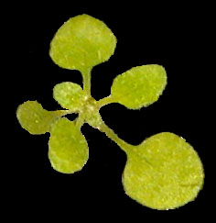
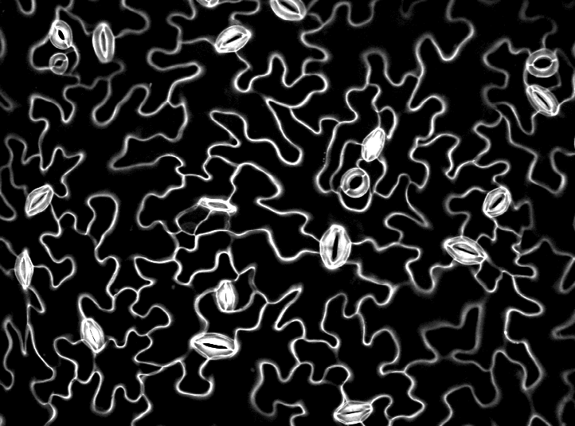
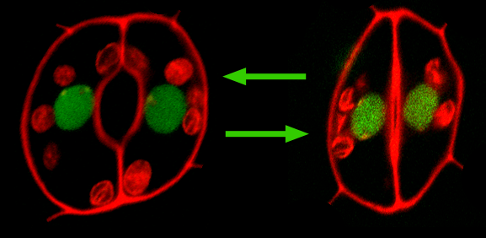
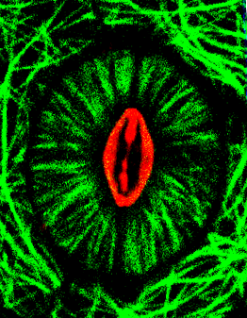
Microtubule Associated Proteins Affect Stomatal Aperture Size
Jessica Lucas and Taylor Kelley
Department of Biology, University of Wisconsin – Oshkosh, Oshkosh, Wisconsin
ABSTRACT
Climate change threatens the productivity of our agricultural plants. Increased heat and drought conditions challenge plants and reduce crop yield. Stomata are epidermal structures on the surface of plant leaves that mediate multiple physiological processes including photosynthesis, thermoregulation and water homeostasis. Hundreds of stomata are found on each leaf, and each stoma is composed of two identical guard cells that surround a central aperture. Guard cells regulate the flow of gases from inside the leaf to the atmosphere through the aperture. The current paradigm is that water pressure within the guard cells determine the size of the aperture and thereby adjust gas exchange to maintain physiological homeostasis. Recent data show a correlation between microtubule organization within the guard cells and aperture size. To further understand the role of microtubules in stomata, we studied the model flowering plant Arabidopsis thaliana harboring genetic mutations in two microtubule associated proteins, KATANIN and ZWICHEL. Cellular observations of wild type stomatal apertures show smaller apertures in the dark than in light, due to the increased photosynthetic activity during the day light. However, stomatal apertures in the katanin and zwichel mutants differed from wildtype and from each other in both the dark and light growth periods. Both KATANIN and ZWICHEL proteins are known to be important for organizing the interphase cortical array of microtubules in Arabidopsis. Therefore our data suggest that microtubule organization is needed for regulating aperture size.
INTRODUCTION
Stomata facilitate gas exchange in plants.
Atmospheric carbon dioxide enters leaves through stomatal apertures for photosynthesis.
Oxygen and water vapor exit the leaves through apertures.
Stomata are pairs of epidermal cells found on all photosynthetic organs. (top, bottom right)
Each stoma is composed of two guard cells that surround a central aperture.
The aperture changes size to regulate gas exchange, thereby regulating photosynthesis, respiration and body temperature.
Arabidopsis thaliana is a model plant for cell and developmental biology. (bottom left)
Hypothesis: Microtubule associated proteins that organize arrays are needed to regulate aperture size.
Experiment: We tested the impact of genetically removing 2 established microtubule associated protein on stomatal aperture size.
The p60 catalytic subunit of the katanin complex is known in Arabidopsis to organize microtubule arrays.
Katanin mutations impact Arabidopsis growth and development in multiple ways.
Zwichel (kinesin-14 family member) is also needed for proper cellular morphogenesis in Arabidopsis.
ZWI is regulated by calcium ions and appears to bundle microtubules.
We measured the length and width of stomatal apertures in katanin and zwichel knock out mutants to determine if these microtubule associated proteins are involved in stomatal movement.
Apertures were measured at 7am and noon, when stomata are closed and open respectively.
Stomata regulate physiological homeostasis.
Internal turgor pressure (water pressure) in the guard cells determines aperture size.
Multiple signaling pathways adjust turgor pressure through cellular ion concentrations in response to environmental and physiological signals.
Changes in turgor pressure are thought to be the primary factor that determines aperture size.
Microtubule organization correlates with aperture size.
Microtubules are radially organized in open stomata (top left). The majority of microtubules in open stomata are bundles with their minus ends near the pore.
Microtubules are sparse, unbundled and disorganized in closed stomata.
More recent data has shown that chemical disruption to microtubules impacts stomatal aperture size.
The mechanistic role of microtubules in aperture regulation is unknown.
RESULTS
The length and width of stomatal apertures significantly differs in both mutants in comparison to wildtype at 7am and noon.
Katanin mutant stomata do not change in width as do the wildtype (left).
Zwichel mutants open larger than wildtype (right).
Katanin and zwichel stomatal apertures
differ from wildtype at both 7am and noon.
CONCLUSION
Both KATANIN AND ZWICHEL proteins are needed to properly regulate stomatal apertures.
These proteins are known for organizing microtubules arrays. A logical next step is to characterize microtubule arrays in katanin and zwichel mutants.
Mechanistically, KATANIN may be needed for sever microtubules to break down the radial array.
The ZWICHEL protein may be needed to bundle microtubules as seen in the open stomata.
A small set of kinesin proteins are highly expressed in Arabidopsis guard cells. ATKC is closed related to kinesin-14 proteins that bundle microtubules into spindle poles in the absence of centrosomes.
We hypothesize that this protein may be important for maintaining the radial array of microtubules in open stomata.
16.2 um
13.5 um
Quantification of katanin and zwichel stomatal apertures
10.8 um
LENGTH Average (N#) | WT | ZWI | p value
7 | 10.5 (600) | 9.7 (773) | 0.003
Noon | 9.7 (592) | 11.4 (452) | <0.0001
p value | 0.0005 | <0.0001
8.1 um
WIDTH Average (N#) | WT | ZWI | p value
7 | 4.1 (600) | 4.1 (773) | 0.93
Noon | 3.7 (592) | 4.5 (452) | <0.0001
p value | <0.0001 | <0.0001
5.4 um
LENGTH Average (N#) | WT | KAT | p value
7 | 10.6 (1155) | 10.4 (1248) | 0.07
Noon | 12.2 (887) | 10.7 (881) | <0.0001
p value | <0.0001 | <0.0001
2.7 um
WIDTH Average (N#) | WT | KAT | p value
7 | 5.0 (1155) | 5.2 (1248) | 0.0002
Noon | 4.6 (887) | 5.3 (881) | <0.0001
p value | <0.0001 | 0.12
Acknowledgements. We thank the UWO Faculty Development Program for funding to support this work. We also thank Fred Sack for the SEM cross section. We thank Elias Martinez Flors and Jewel Tulod for supplementary data analysis.
References. Bichet et al. 2001 Botero is required for normal orientation of cortical microtubules and anisotropic cell expansion in Arabidopsis. The Plant Journal.
Burk et al. 2001 A katanin like protein regulates normal cell wall biosynthesis and cell elongation. The Plant Cell.
Liu and Lee 2001 Kinesin-related proteins in plant cytokinesis. Journal of Plant Growth Regulation.

