Slide 1
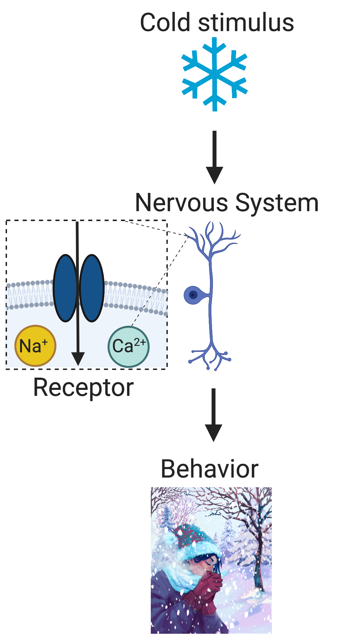
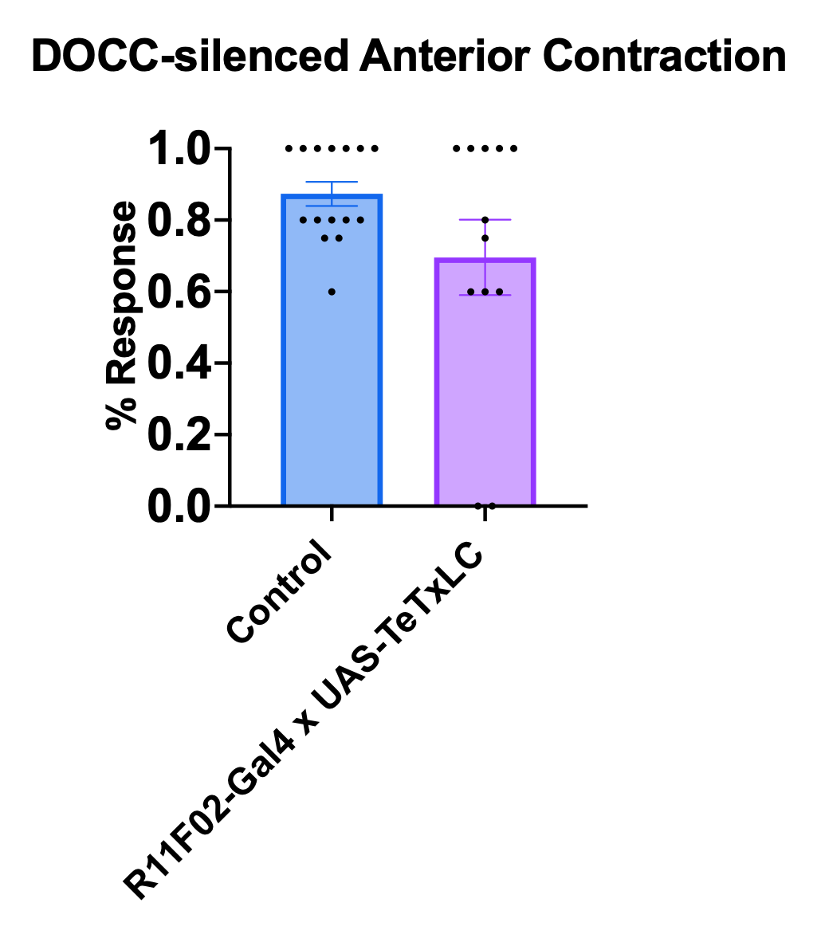
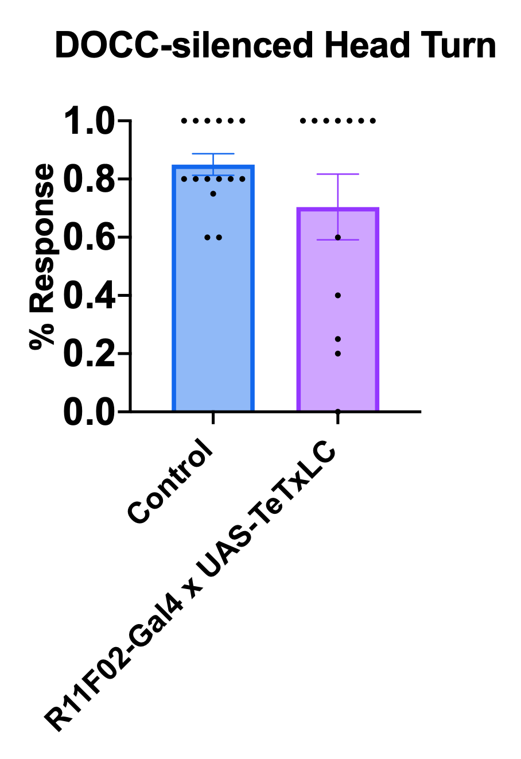
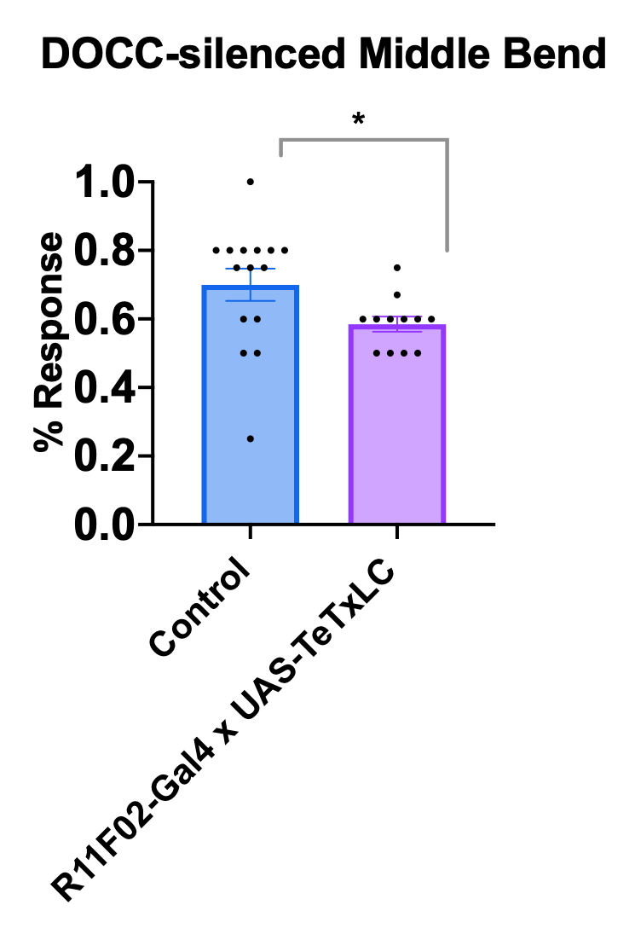
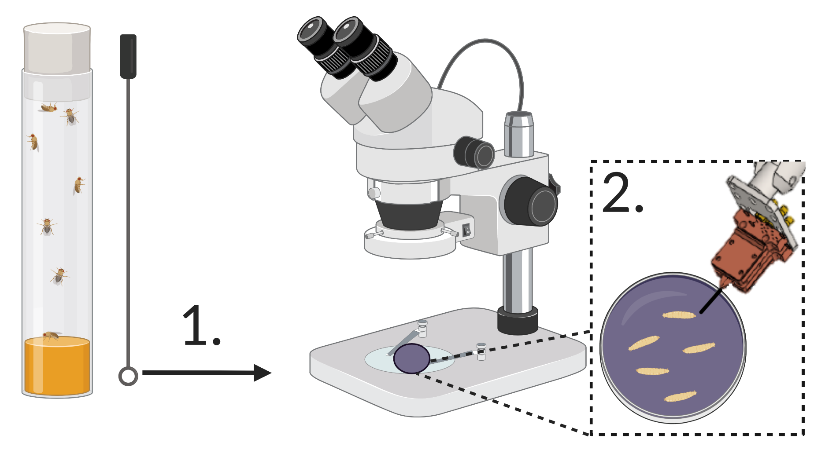
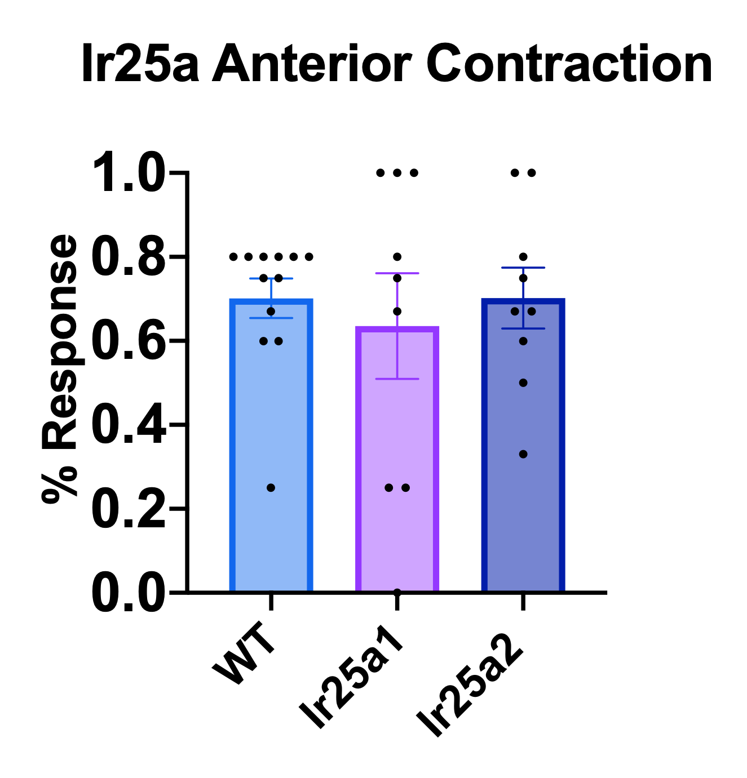
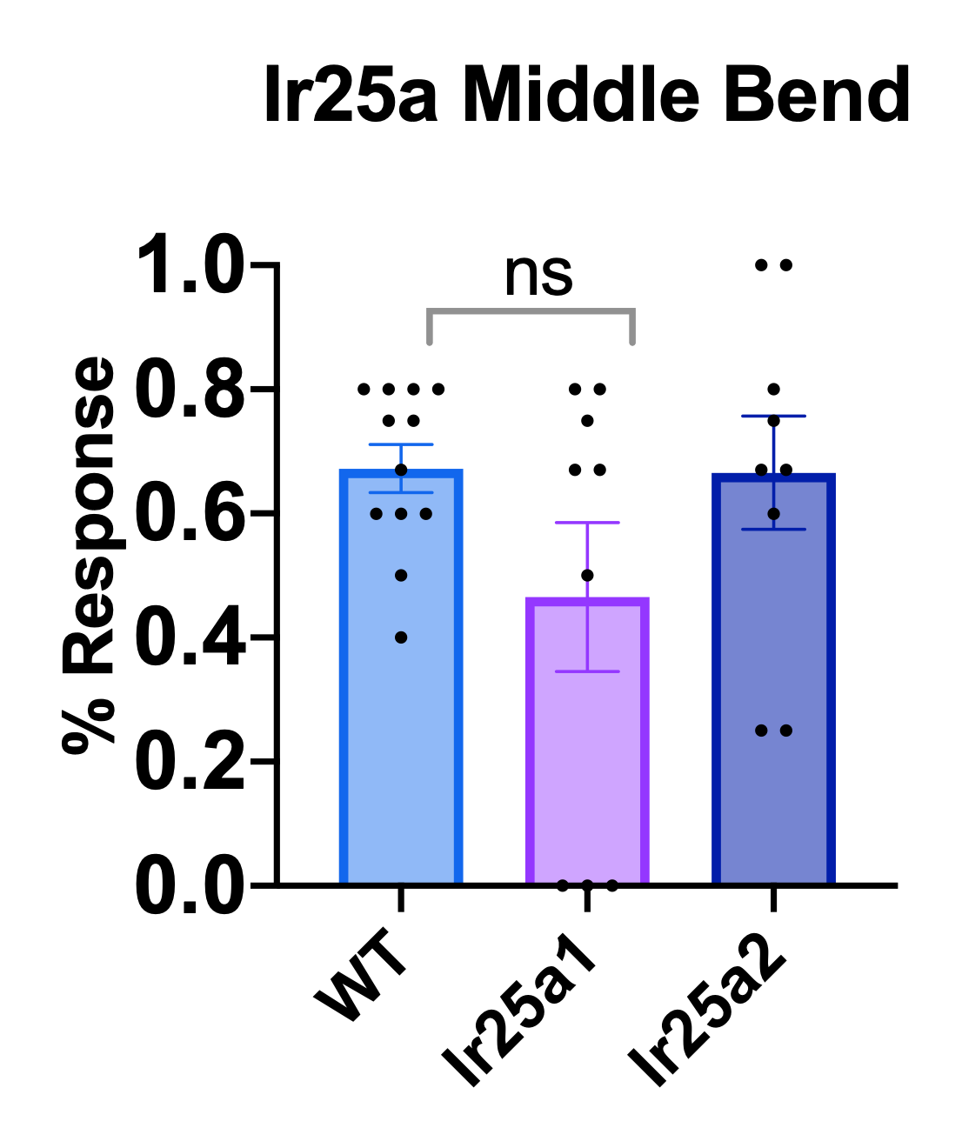
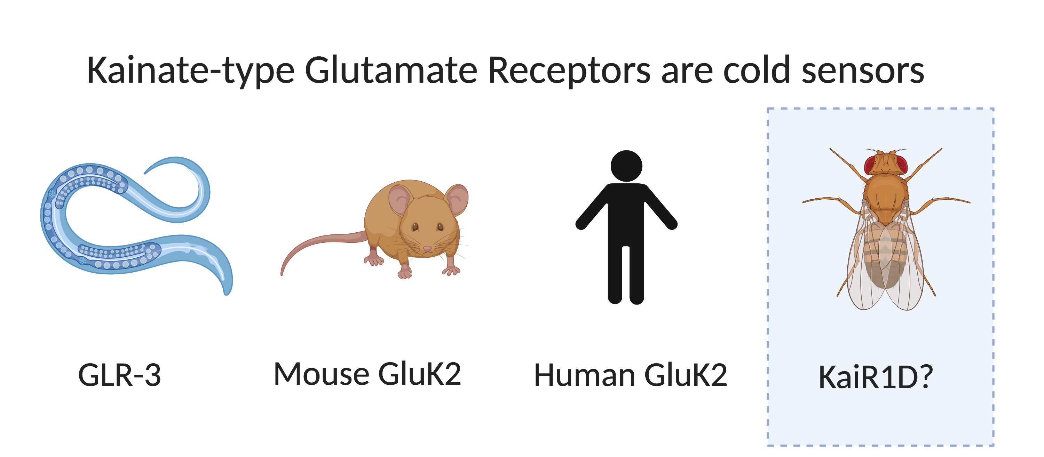
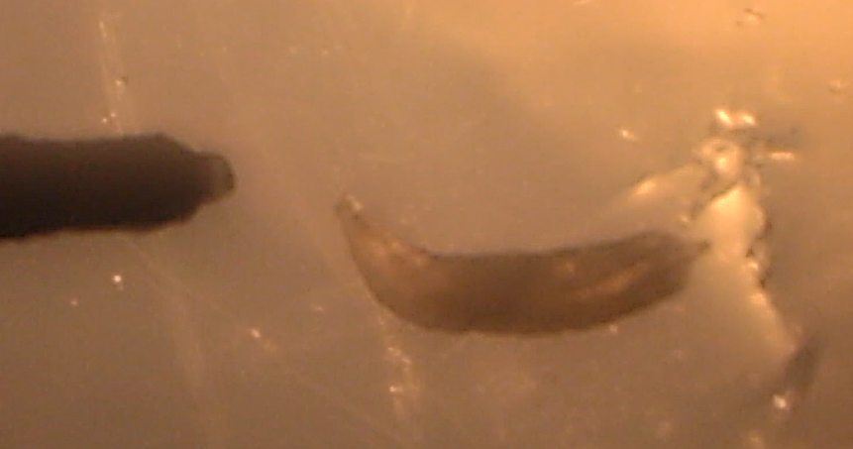
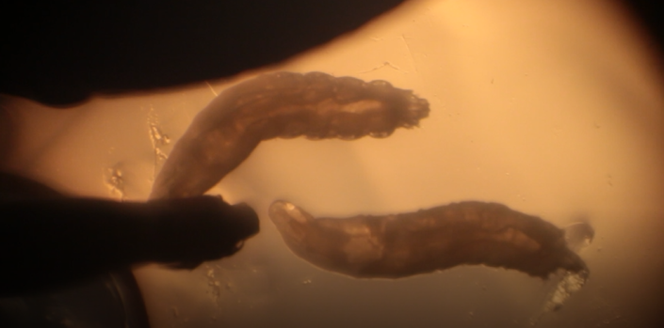
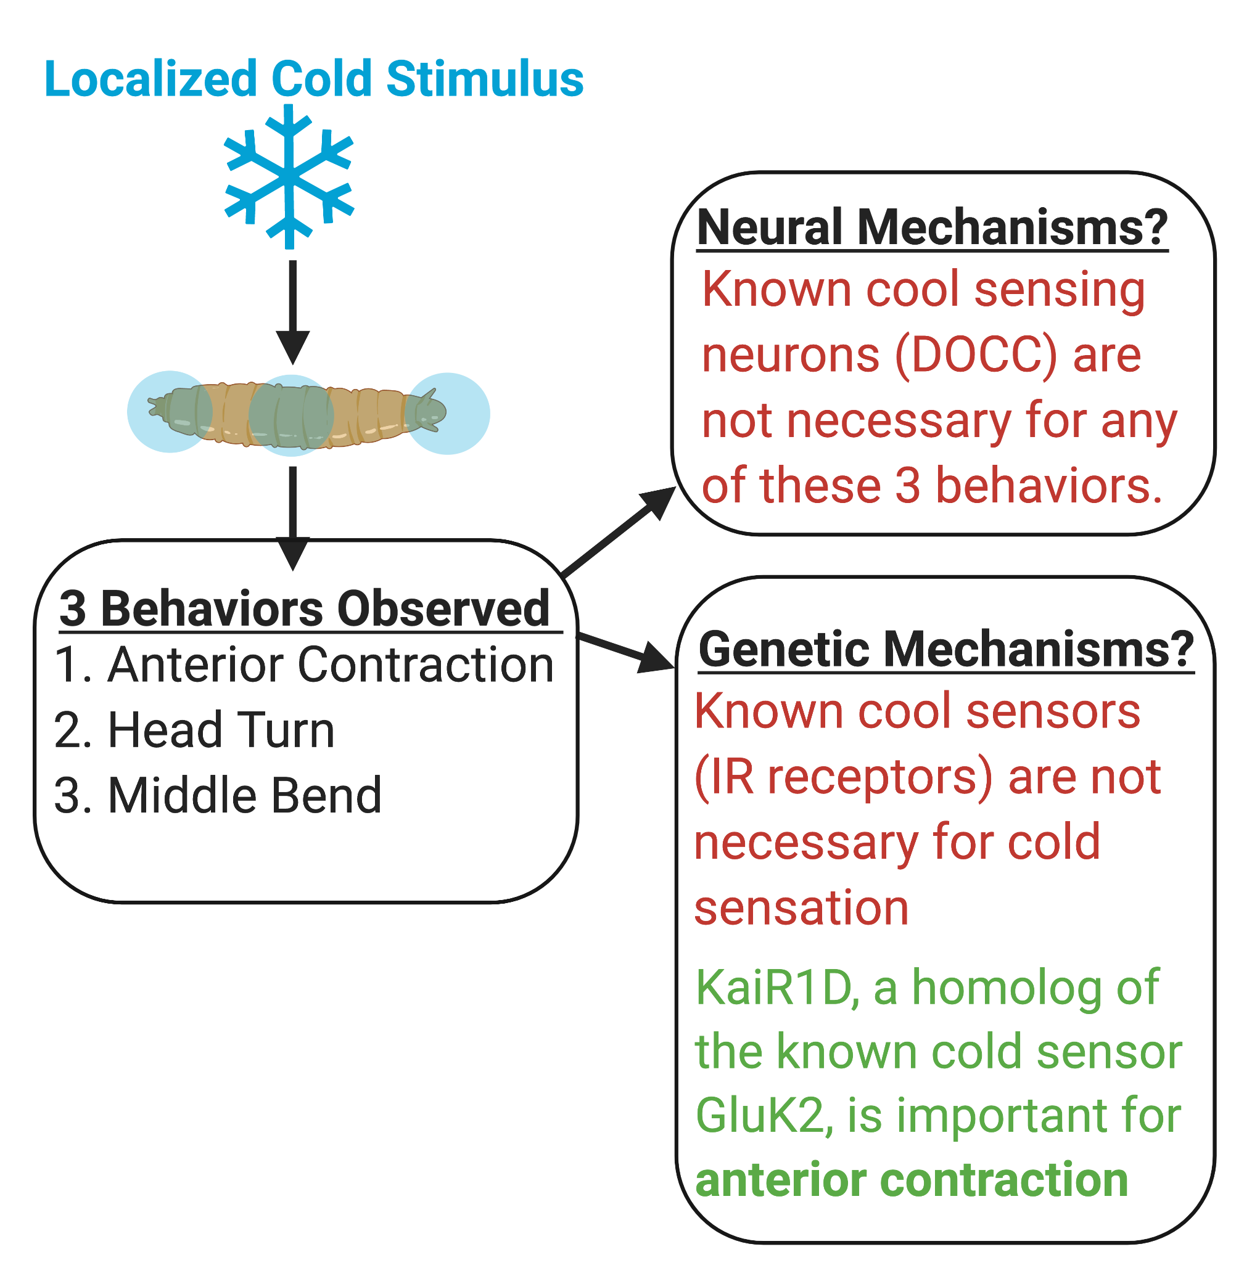
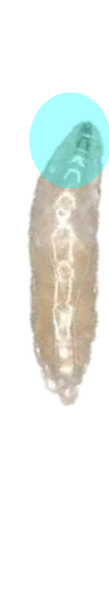
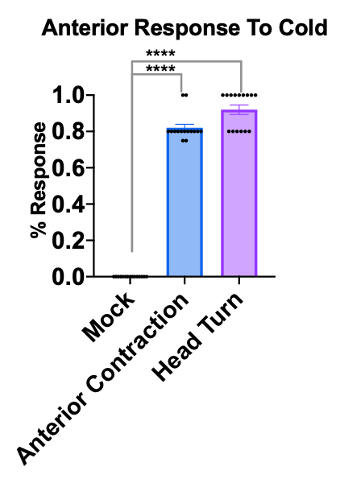
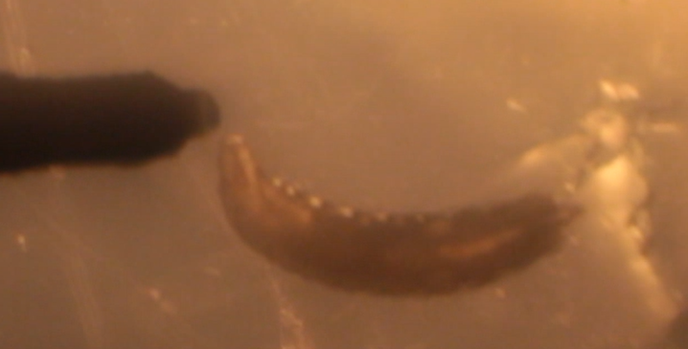
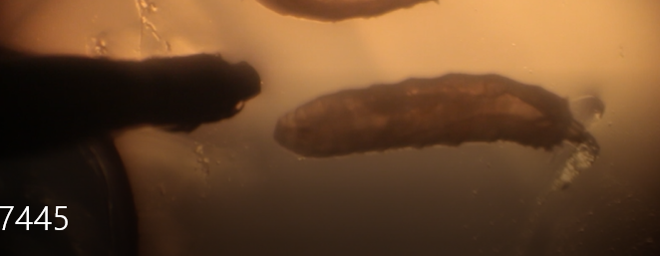
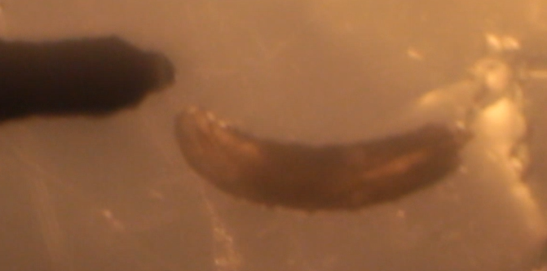
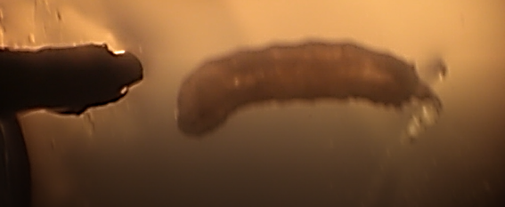
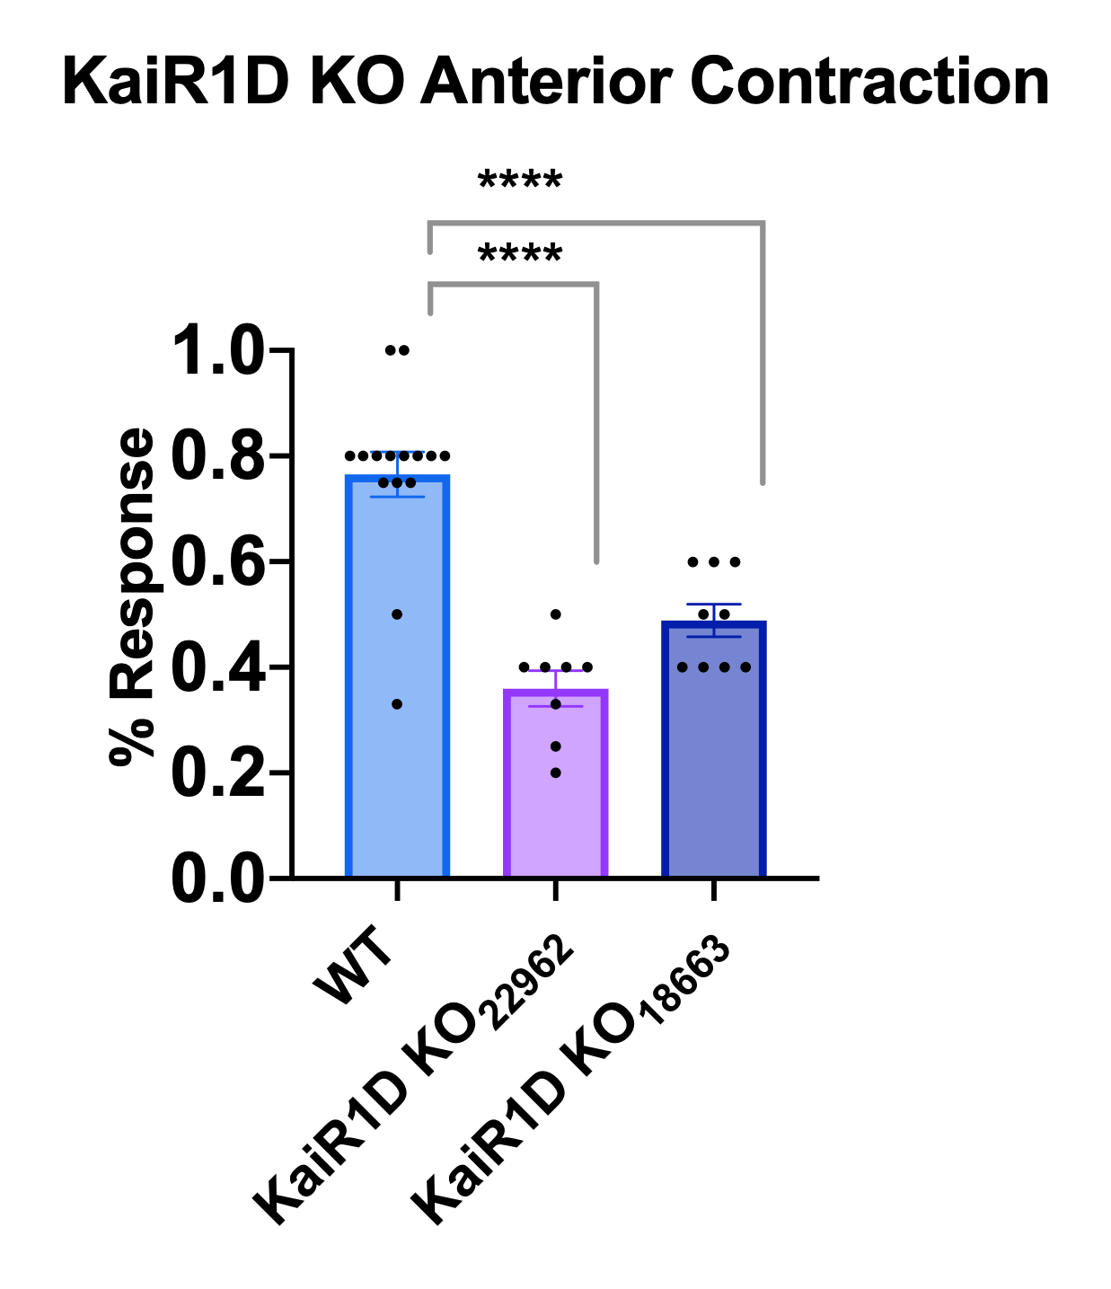
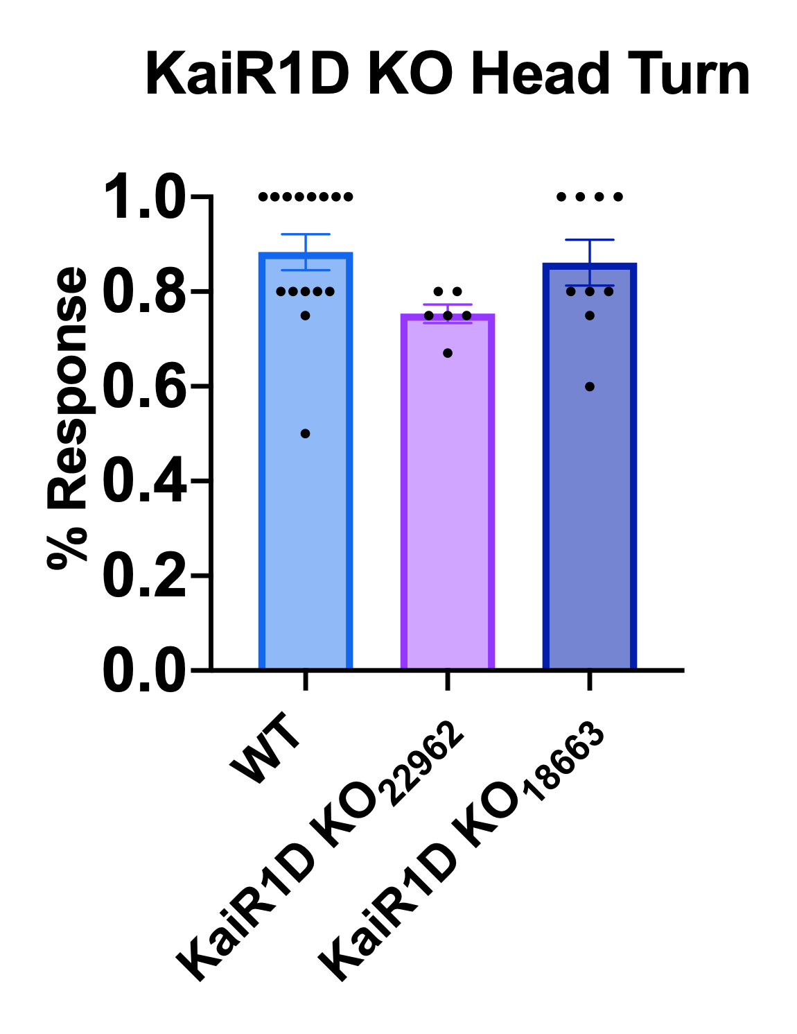
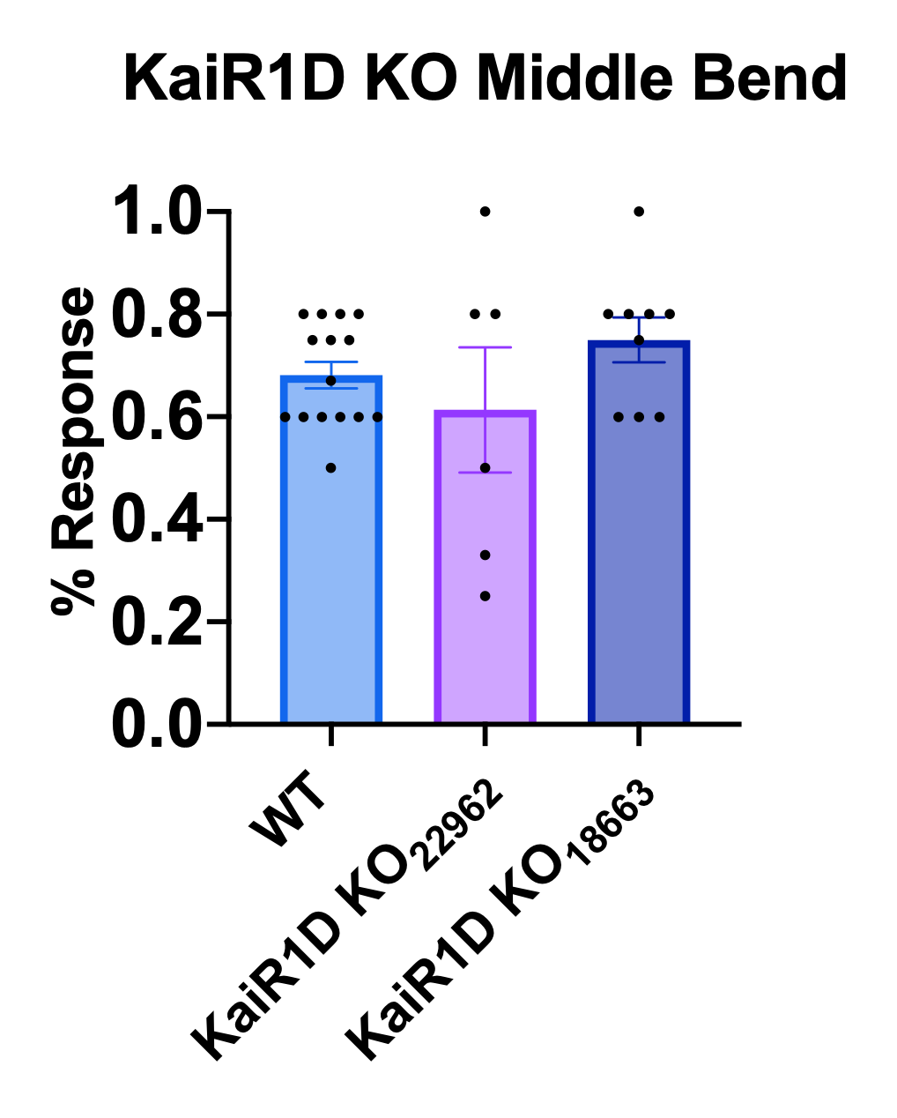
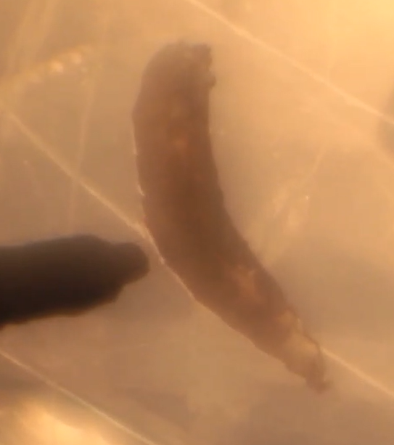
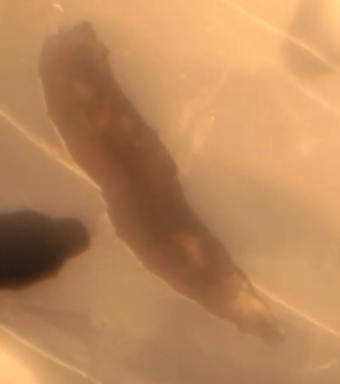
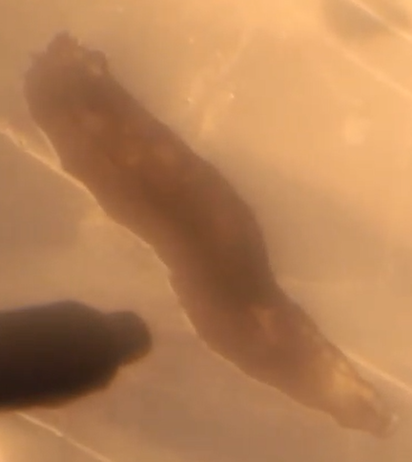
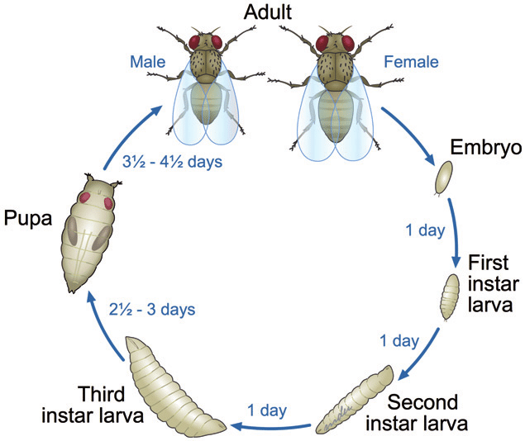
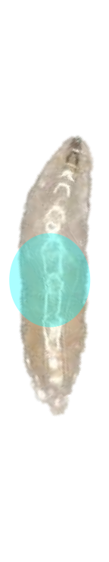
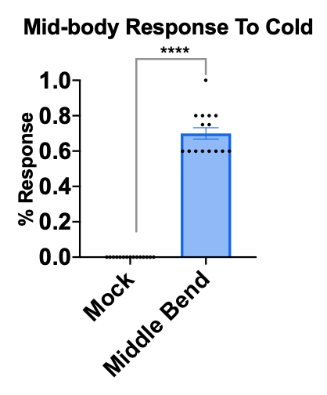
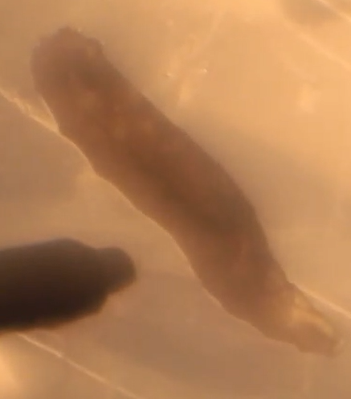
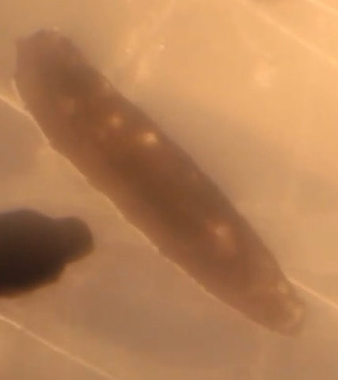
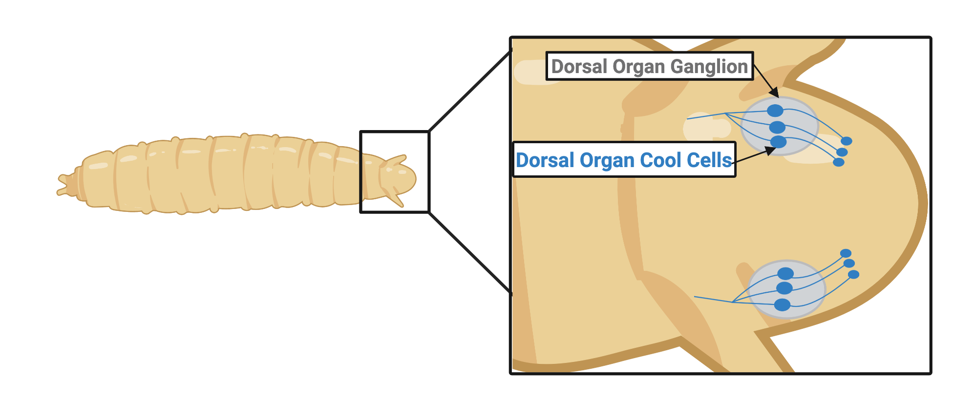
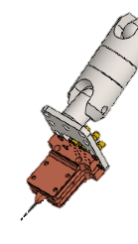
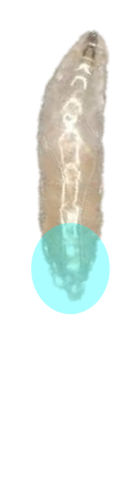
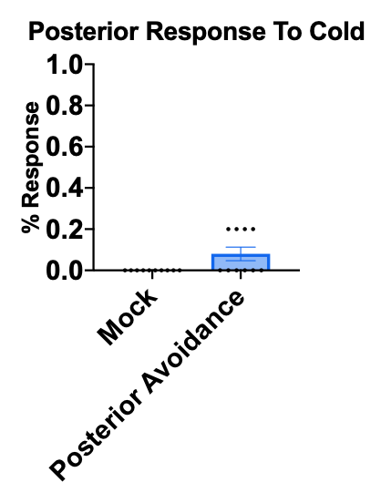
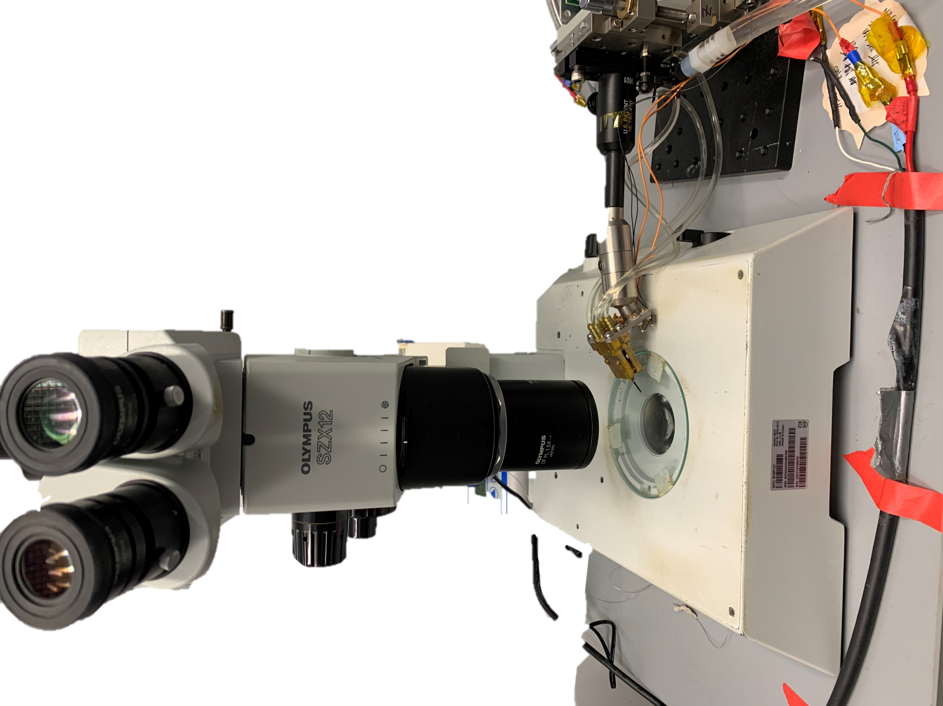
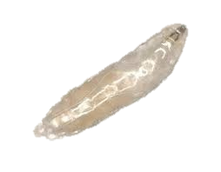
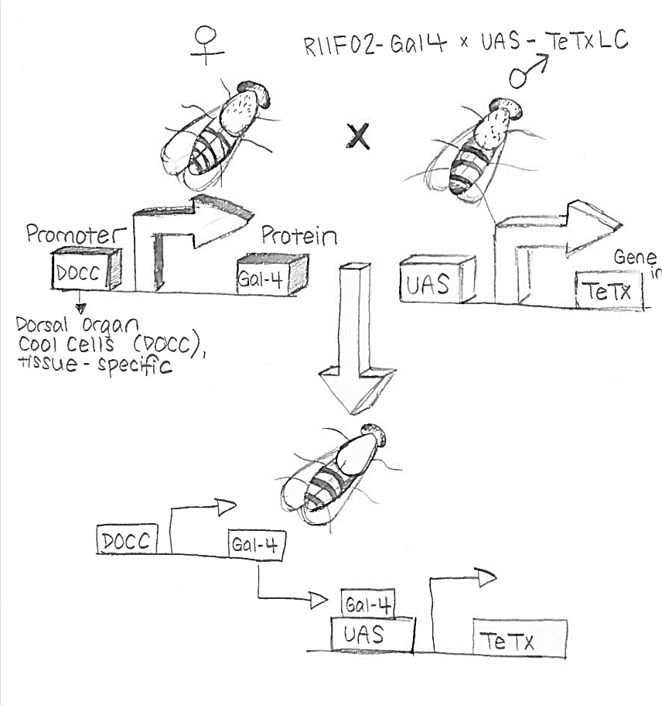
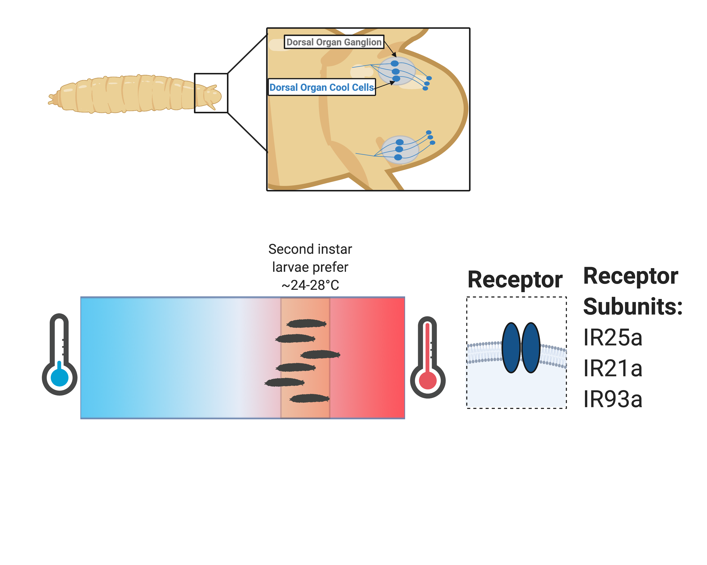
1. Introduction
Neural and Genetic Basis of Cold Sensation in Drosophila Melanogaster
Amanda Xu ₁, Elizabeth A. Ronan ₁ ₂, Gun-Ho Kim ₃, Limei Zhu ₁, Bing Ye ₁, ₄
13. Cool-sensing neurons are not required for cold sensation
Humans must sense temperature in order to survive. While heat sensation has been extensively studied, much less is known about cold sensation. Cold temperatures are detected by cold-sensing receptors expressed in sensory neurons in the nervous system. However, the identities of these receptors and neurons are unclear.
The complexity of human biology makes it difficult to study cold sensation in humans. Because the basics of sensory mechanisms tend to be conserved from animals to humans, I seek an animal model to study cold sensation.
7. Experimental Procedure
10. Cool receptors are not required for
cold sensation
A
B
C
For each trial, I tested 5 larvae at a time.
Sample size (n) was ≥ 8 trials for each condition, for a total of ≥ 40 larvae tested in total.
I calculated the average response for each trial using Microsoft Excel and graphed the results in GraphPad Prism.
Statistical tests were performed using GraphPad Prism to determine whether groups were significantly different.
Statistical tests used:
  t-test for comparing means of 2 groups.
  ANOVA for comparing means of more than 2 groups.
A
B
C
9
9
9
9
9
9
12
9
9
12
9
9
9
12
9
A and B: Bar graphs. Error Bars, SEM n ≥ 5. ****p < 0.0001 (ANOVA with Bonferroni test).
C: Bar graph. Error Bars, SEM n ≥ 5.
*p < 0.434 (ANOVA with Bonferroni test).
A-C: Bar graphs. Error Bars, SEM n ≥ 5. ****p < 0.0001 (ANOVA with Bonferroni test).
14. Conclusions
2. Research Questions
8. Drosophila respond robustly to cold
11. KaiR1D, a candidate cold receptor, is important for cold sensation
We developed the fruit fly as a model to study cold sensation
Fly larvae exhibit robust avoidance responses to cold temperatures
1. Do animals sense cold, and if so, how?
2. What are the genes and neurons that mediate cold sensation?
A. When the probe is directed at the head of the larva, I observed 2 behaviors:
anterior contraction: the anterior segment of larva withdraws
head turn: both the larva’s nose and anterior segment turns away from the probe; an act of evasion.
Anterior Contraction
Head Turn
[5]
0s
0s
3. Hypothesis
1s
1s
I hypothesize that cold temperatures will evoke an avoidance behavior in animals because organisms and humans tend to avoid harmful stimuli in order to survive.
If cold evokes an avoidance behavior in animals, I also hypothesize that there are cold-sensing receptor proteins and neurons in animals to mediate this avoidance behavior.
To test these hypotheses, I will test mutants lacking candidate genes and those defective in sensory neuron function to uncover the mechanisms underlying the behavioral response to cold.
2s
A
B
C
15
15
2s
15
3s
B. When the probe is directed at the middle of the larva, they exhibit middle bending behavior: middle region (upper middle and/or middle posterior segment) of larva bends away from the probe
Middle Bending
15
9
15
6
9
15
6
9
4. Model Organism: The Fruit Fly
0s
1s
2s
9
Life Cycle of the Fruit Fly
A-C: Bar graphs. Error Bars, SEM n ≥ 5. ****p < 0.0001 (ANOVA with Bonferroni test).
3s
4s
12. What are the neural pathways mediating cold sensation?
15
15
[3]
15. Future Directions
The Dorsal Organ Ganglion (DOG) houses 3 cool sensing neurons (Dorsal Organ Cooling Cells, DOCCs)
Identify sensory neurons important for cold sensation by:
  Silencing different groups of sensory neurons using Gal4 drivers
  Characterizing the expression pattern of KaiR1D
Determine if these sensory neurons are cold sensitive
Identify cold-sensing receptors important for head turn and middle bending
C. When the probe is directed at the posterior region of the larva, they do not respond.
Experiment Conclusions:
Observed two anterior behavioral responses to cold
  Anterior Contraction
  Head Turn
Observed middle bend behavior
Next steps:
What genes are required for the temperature behaviors observed?
Which neurons are important for the cold avoidance behaviors?
5. Temperature Device Set Up
10
10
GAL4-UAS System
16. References
A-C: Bar graphs.
Error Bars, SEM. n ≥ 8.
A) ****p<0.0001(ANOVA with Bonferroni test)
B)****p < 0.0001 (t test).
[1] Nakamura, K. (2011). Central circuitries for body temperature regulation and fever. AJP: Regulatory, Integrative and Comparative Physiology, 301(5), R1207–R1228. http://doi.org/10.1152/ajpregu.00109.2011
[2] Garrity, P A et al. “Running Hot and Cold: Behavioral Strategies, Neural Circuits, and the Molecular Machinery for Thermotaxis in C. Elegans and Drosophila.” Genes & Development 24.21 (2010): 2365–2382. Web. https://www.ncbi.nlm.nih.gov/pmc/articles/PMC2964747/
[3] Barbagallo, Belinda, and Paul A Garrity. “Temperature Sensation in Drosophila.” Current Opinion in Neurobiology 34 (2015): 8–13. Web. https://www.ncbi.nlm.nih.gov/pmc/articles/PMC4508239/
[4] Ni, Lina, et al. “The Ionotropic Receptors IR21a and IR25a Mediate Cool Sensing in Drosophila.” ELife, ELife Sciences Publications, Ltd, 29 Apr. 2016, elifesciences.org/articles/13254
[5] Gong, Jianke, et al. “A Cold-Sensing Receptor Encoded by a Glutamate Receptor Gene.” Cell, Cell Press, 29 Aug. 2019, www.sciencedirect.com/science/article/pii/S0092867419308335.
[6] Cai, Yu. “Life Cycle of the Fruit Fly Drosophila.” Researchgate.net, July 2014, www.researchgate.net/profile/Yu_Cai3/publication/264127592/figure/fig1/AS:601624363954206@1520449834722/The-whole-life-cycle-of-the-fruit-fly-Drosophila-is-relatively-rapid-and-takes-only.png.
Life Sciences Institute, University of Michigan, Ann Arbor, MI 48109, US
Department of Molecular and Integrative Physiology, University of Michigan, Ann Arbor, MI 48109, USA
Department of Mechanical Engineering, Ulsan National Institute of Science and Technology, 50 UNIST-gil, South Korea
Department of Cell and Developmental Biology, University of Michigan, Ann Arbor, MI 48109, USA
6. Methods
9. Do cool sensors play a role in cold avoidance?
Materials and Maintenance
Mid Third-instar larvae were tested because it is easier to quantify their behavior compared to the flying adults.
In order to maintain the flies:
1) Set up breeding/cross among the parents.
2) Grow in narrow vials
3) After 5 days, pick third-instar larvae
Materials:
Fly Food narrow vials: 9 ml of food/vial. Made of Agar, Yeast, Soy Flour, Yellow Cornmeal.
2 petri-dishes
Tweezers
Grape juice plate with 2% solidified sugar
Fly loop
ddH2O (double-distilled water)
Paintbrush
Olympus Microscope
Ionotropic Receptors (IRs) could possibly mediate cold sensation in fruit flies. IRs belong to the ionotropic glutamate receptor (iGluR) family that have been extensively studied in invertebrate chemical sensation and recently, temperature sensation. [3]
Notes:
Minimum recommended text sizes are: 85 pt font for the main title, 36 pt for subheadings, 24 pt for body text, and 18 pt for captions. Less text = more visitors to your poster

