Slide 1
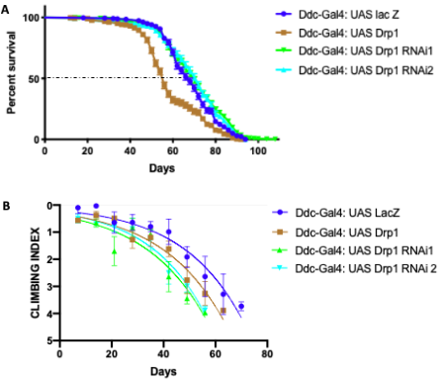
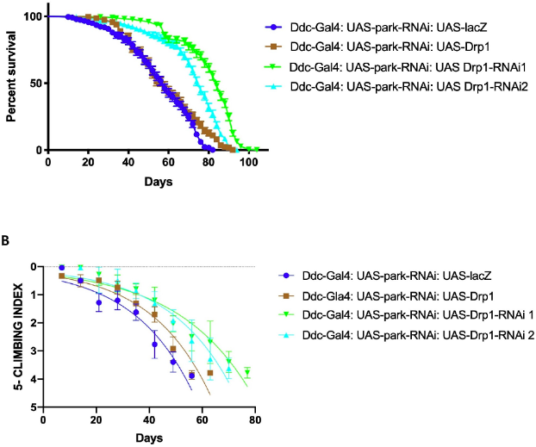
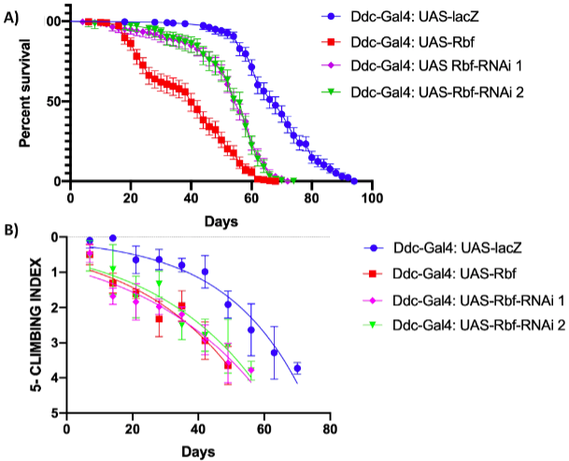
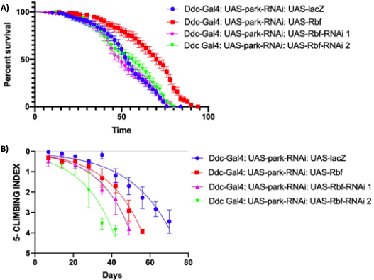
Altered expression of Drp1 and Rbf1 in selected neurons
Azra Hasan¹ and Brian E. Staveley¹
¹Department of Biology, Memorial University of Newfoundland. St Johns’, Newfoundland and Labrador, Canada
Background Information
Parkinson Disease (PD) and other neurodegenerative diseases can be caused by mitochondrial dysfunction. Mitochondrial health is affected by the relationship between, the mitochondrial fission protein Drp1, the transcriptional regulator Rbf1 and the E3 ubiquitin ligase parkin.
Results
A
Loss of function of Drp1 in selected neurons increased average lifespan but decreases locomotor ability. Gain of function in selected neurons can decrease lifespan and climbing ability.
Loss-of-function of Drp1 and parkin results in a longer median lifespan & improved climbing ability then loss-of either Drp1 or parkin. The inhibition of parkin has no affect on the loss of Drp1 phenotype.
The directed expression of Rbf1 loss and gain of function in selected neurons reduces average lifespan & climbing ability over time.
However, in combination with parkin loss of function, directed expression of Rbf1 results in increased lifespan but compromised climbing ability.
Discussion
The compromised climbing abilities in flies with directed inhibition of Drp1 has produced a new model for Parkinson Disease and can be used to further investigate the mechanisms underlying neurodegenerative diseases. In an apparent case of synergy, loss-of-function of both Drp1 and parkin results in extended lifespan. The directed expression of Rbf1 recues the parkin loss of function phenotype, hence directed expression of Rbf1 seems to control mitochondrial health.
Reference:
1. Clavier A, Ruby V, Rincheval-Arnold A, Mignotte B, Guénal I. The Drosophila retinoblastoma protein, Rbf1, induces a Debcl- and Drp1-dependent mitochondrial apoptosis. J Cell Sci. 2015;128:3239–49. doi:10.1242/jcs.169896.
2. Filichia E, Hoffer B, Qi X, Luo Y. Inhibition of Drp1 mitochondrial translocation provides neural protection in dopaminergic system in a Parkinson’s disease model induced by MPTP. Sci Rep. 2016;6:32656
Funded by School of Graduate Studies Fellowship, Memorial University of Newfoundland and by an NSERC Discovery Grant.

